Slide 1
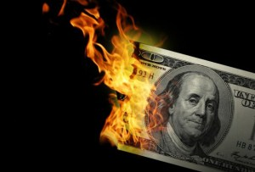
CS1951 L
Blockchains & Cryptocurrencies
Spring 2023
Lecture 22
Regulation
Maurice Herlihy
Brown University
Notes:
Custody section needs reorganization

Slide 2
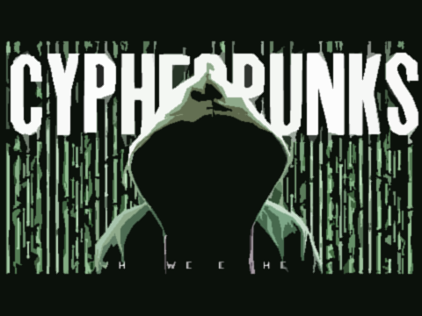
1980s and 1990s
Cryptocurrencies and blockchains originate from the cypherpunk movement
Protect personal privacy from government surveillance
Cryptography for the people!
Notes:
Image from https://www.youtube.com/watch?v=PIrhyN6KHSc&t=4s&ab_channel=TheSwervePodcast

Slide 3
Then and Now
At first …
Bitcoin and other cryptocurrencies
promoted as a way to evade government censorship and regulation
Today …
DeFi is a multi-billion dollar industry
Regulation is inevitable
Notes:
Image:https://www.hiclipart.com/free-transparent-background-png-clipart-ppkgg/download

Slide 4
This Lecture
Basic regulatory terminology, concepts
Securities
Commodities
Custody
Notes:
Image from https://www.youtube.com/watch?v=PIrhyN6KHSc&t=4s&ab_channel=TheSwervePodcast

Slide 5
Warning!
Regulatory situations can change dramatically
This is not legal advice!
This will help you …
Decide when you need a lawyer …
… and converse intelligently when you get one
Notes:
Image from https://www.youtube.com/watch?v=PIrhyN6KHSc&t=4s&ab_channel=TheSwervePodcast

Slide 6
Regulation is Hard
Financial regulators have multiple, sometimes conflicting, missions
protect individual investors from fraud, manipulation, etc.
ensure that markets are fair, orderly, and efficient
Here: focus on US (EU may differ)

Slide 7
Regulating Crypto is Harder
20th-century regulations for 21st-century technologies?
Volatile: value changes quickly
Anonymous: hard to trace
Mixed record of security
Easily traded across borders

Slide 8
Good Regulation can Help
Businesses hate legal uncertainty
Encourage innovation via “safe havens”
Better risk management
Institutional investors require transparency
Only regulation can take Crypto mainstream

Slide 9
Bad Regulation can Hurt
High costs could stifle innovation
Complexity, ambiguity could deter adapters
Cryptocurrencies seen as risky, undesirable
Harm to privacy, decentraization
Over-zealous regulation makes trading hard

Slide 10
Securities vs Commodities

Slide 11
Securities vs Commodities
How do regulators view cryptocurrencies?
Either as securities or as commodities
Some have been deemed securities
Some have been deemed commodities
Wait, what?

Slide 12
Protect individual investors by ensuring that markets are free of fraud, manipulation, and other misconduct
Ensure that markets are fair, orderly, and efficient
(Missions not always aligned)

Slide 13
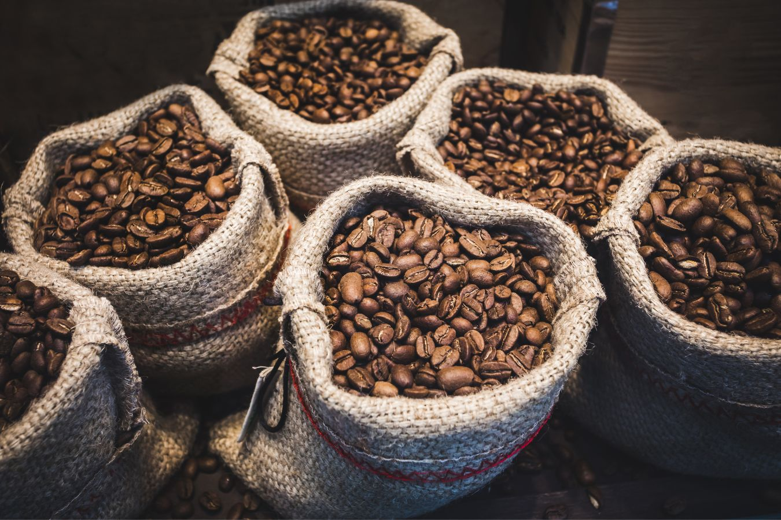
Commodities
A tangible or virtual good
E.g., gold, soybeans, coffee, etc.
typically bought and sold on public exchanges
Value influenced by various market forces
Less tightly regulated than securities
Notes:
Image:https://i0.wp.com/helenacoffee.vn/wp-content/uploads/2022/08/what-does-a-standard-coffee-bag-weigh-5-2.jpg?fit=1350%2C900&ssl=1

Slide 14
Mission:
to promote the integrity, resilience, and vibrancy of the U.S. derivatives markets through sound regulation.
polices the derivatives markets for various abuses and works to ensure the protection of customer funds
Regulating commodities (arguably) simpler

Slide 15
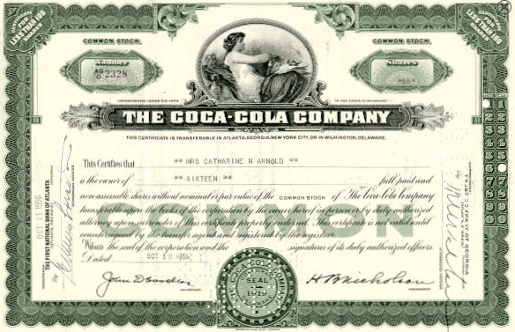
When is Something a Security?
“Howey Test”
investment of money in a common enterprise
reasonable expectation of profits
derived from the efforts of others
SEC v. W.J. Howey Co. 1946
Notes:
https://www.investopedia.com/thmb/8gigmUAkh79VuBkqd0C28mjtmio=/750x0/filters:no_upscale():max_bytes(150000):strip_icc():format(webp)/coca-cola-stock-certificate-56a091355f9b58eba4b1a1e1.png

Slide 16
Applied to Cryptocurrency?
offered for sale to investors
promise, explicit or implicit, of profit
Investments must flow to a central authority,
(person, company, or organization),
in charge of creation, promotion, and sale.

Slide 17
Consequences of being a Security
Must register with SEC
Must provide investors with various disclosures
Subject to various Securities Acts
Issuer is liable for misstatements, omissions
Investors can sue for damages, refunds

Slide 18
Consequences of being a Commodity
Regulated by CFTC, not SEC
Taxed differently than securities
Can be traded on regulated exchanges
Better liquidity, stability
May attract institutional investors

Slide 19
Summary so far
If you are designing a cryptocurrency
Better to be a commodity than a security
But you should welcome good regulation
Legal situation still uncertain

Slide 20
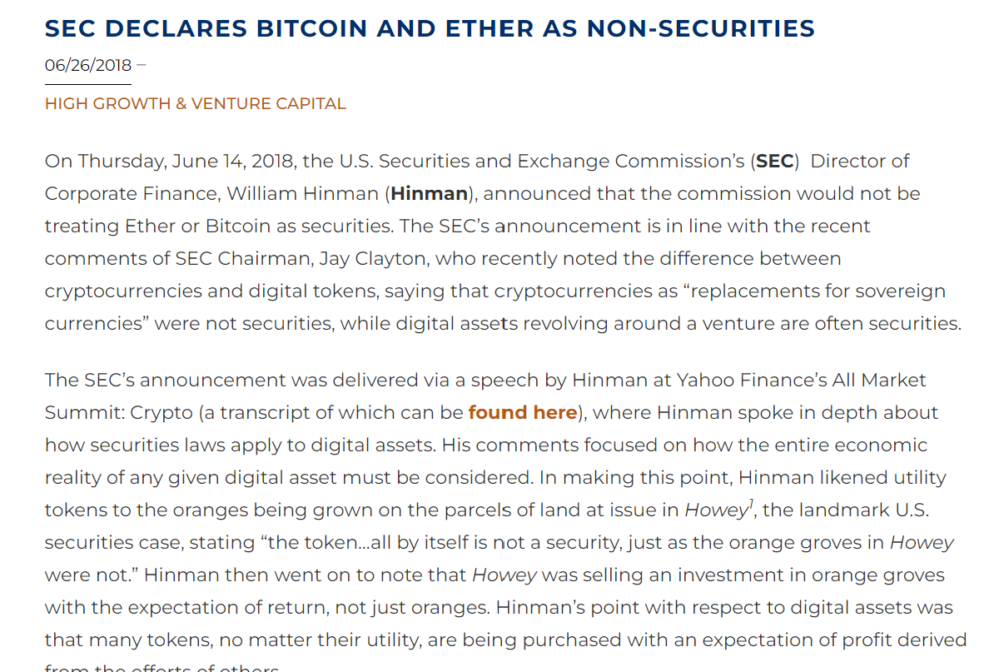
Case Study: Ethereum 2018
SEC declared
In 2016, Ether was probably a security
Profit from founders’ efforts
By 2018, probably a commodity
Decentralized enough

Slide 21
Case Study: Ethereum Today
Today, values flow from
Platform for decentralized apps
& smart contracts
Maybe applies to Bitcoin & forks & others?
SEC silent on scope

Slide 22
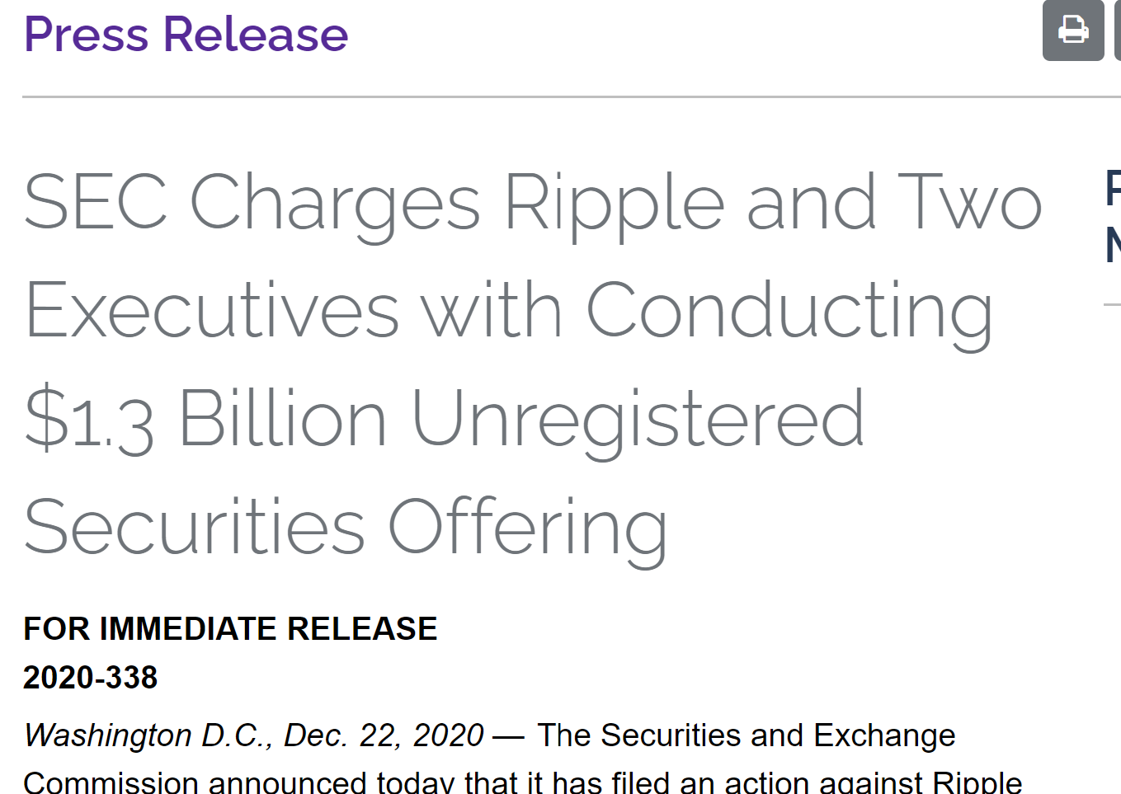
Case Study: Ripple Labs 2020
SEC vs Ripple Labs (XRP cryptocurrency)
Unregistered securities offering > $1.3 B
When it sold XRP to investors
At stake: is most crypto a security?
Case is ongoing

Slide 23
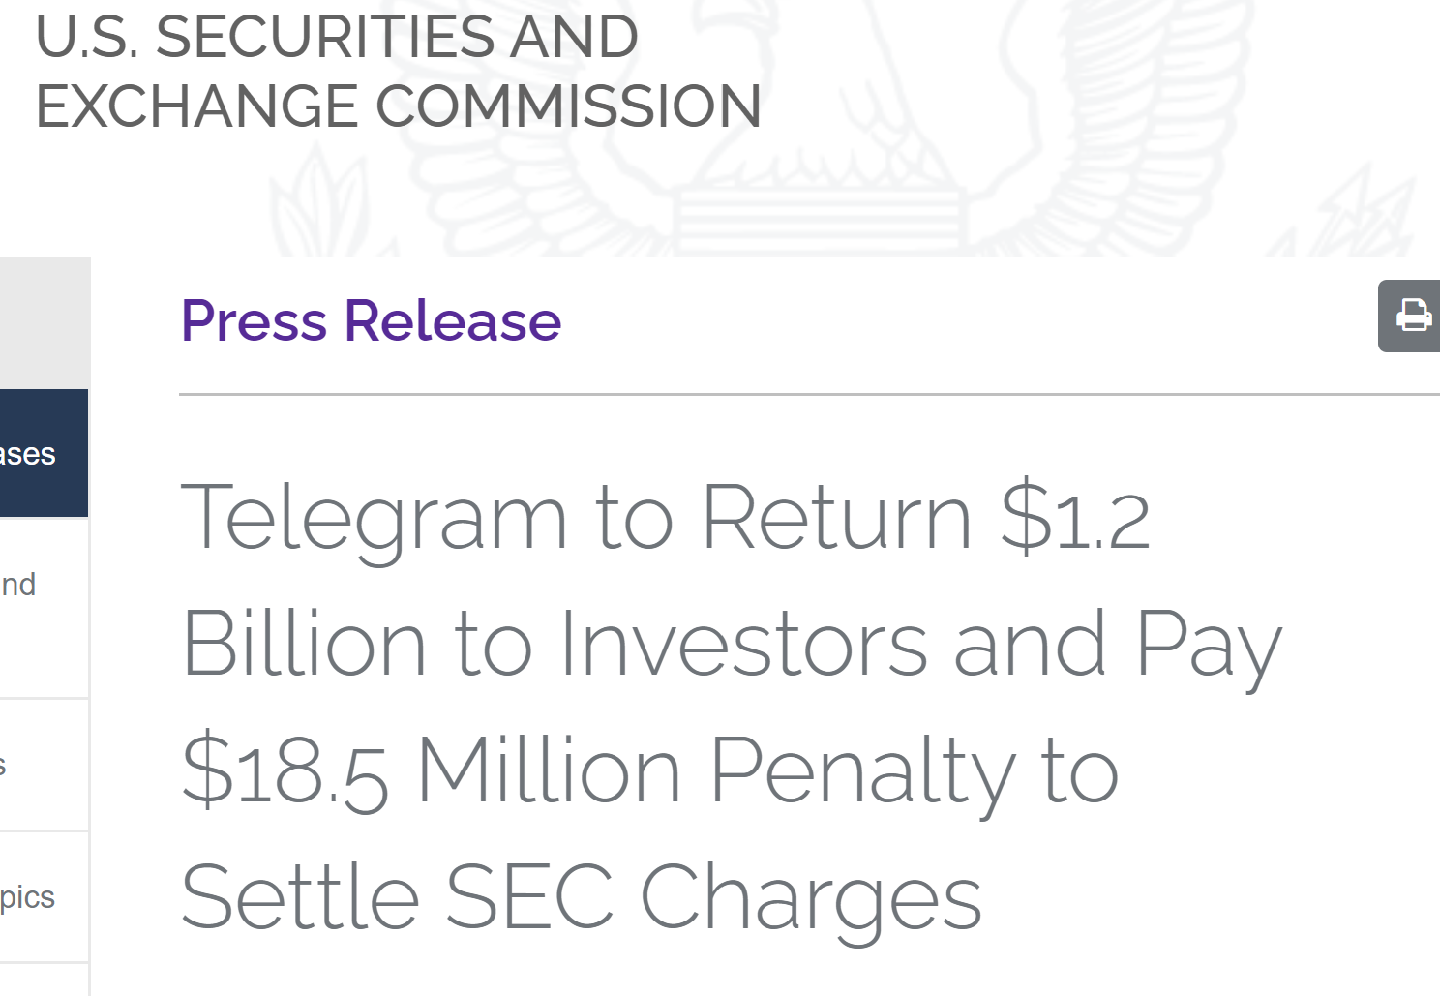
Case Study: Telegram 2019
SEC vs Telegram (messaging app)
Pre-sale of GRAM tokens to investors
Which investors re-sold ..
Was unregistered securities offering
Court order to stop

Slide 24
Initial Coin Offerings

Slide 25
Initial Coin Offerings
A company seeks to raise money …
By selling coins or tokens
No ownership rights (unlike stock)
Can be exchanged for services, or resold
Is this a security?

Slide 26
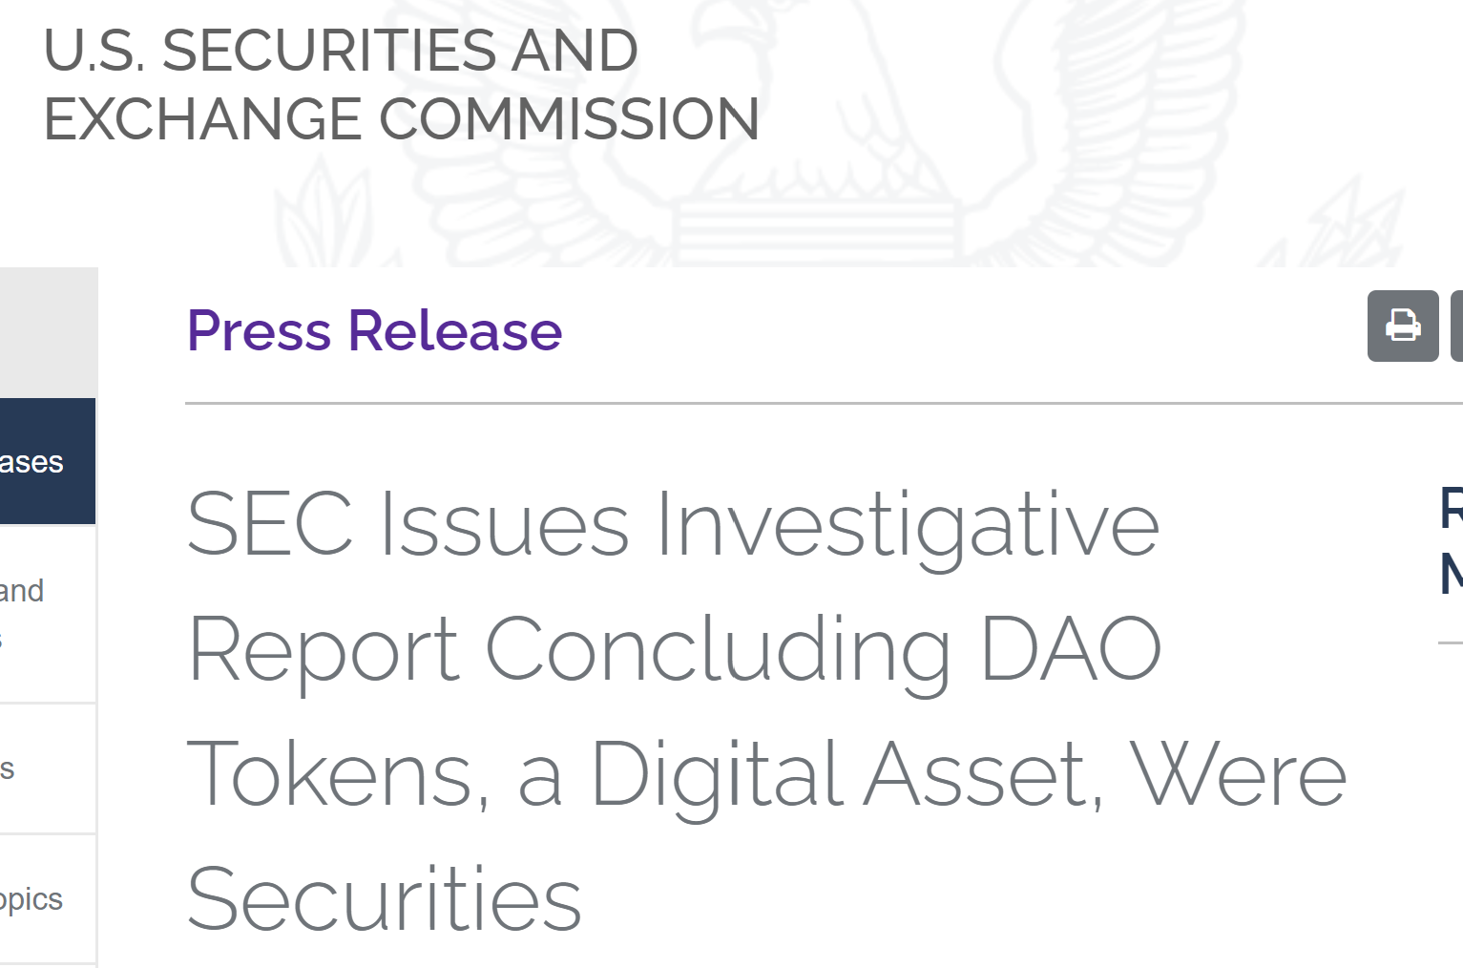
Case Study: DAO 2017
Yes, that DAO
SEC deemed DAO token to be a security
Value of DAO tokens plummeted
DAO delisted from exchanges, shut down
SEC declined to prosecute

Slide 27
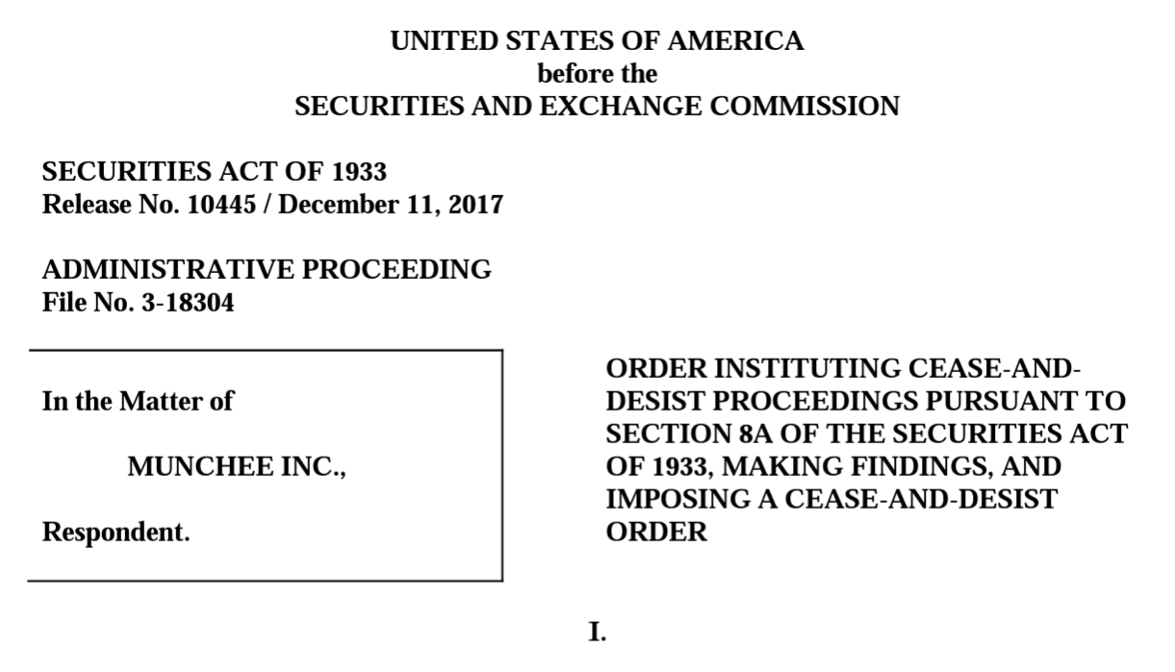
Case Study: Munchee 2017
ICO token to buy & sell food reviews on apps
Funds raised used to hire developers
Marketed: can buy services (but not really)
Marketed: resale value would increase
SEC: token is an investment
Also, SEC: cease-and-desist order

Slide 28
Utility Tokens
Access to product or service
Value from platform functionality
Not from anticipated market price
Not used to raise money for development
Not securities

Slide 29
Case Study: Turnkey Jet 2019
Token sales not used for development
Tokens immediately usable
Tokens restricted to internal wallets
Company sells at fixed price, re-buys at discount
Not marketed as investments
SEC: not securities (“no-action letter”)

Slide 30
Custody: 1931 vs 2024

Slide 31
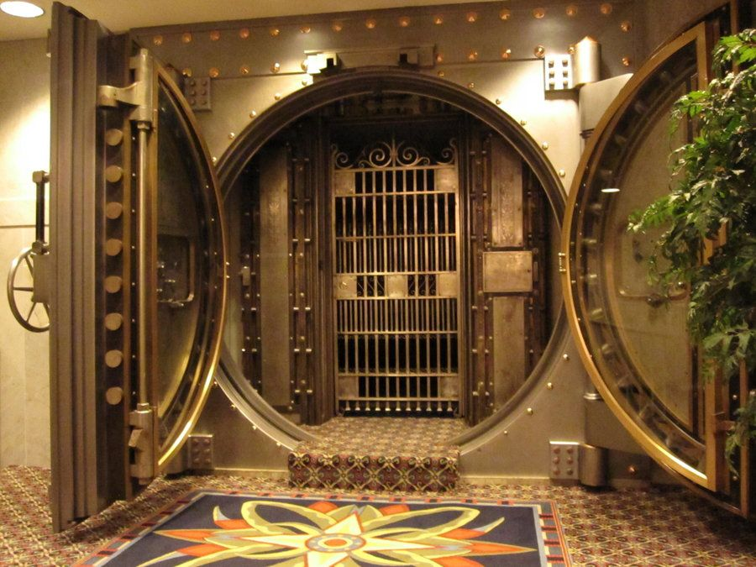
Where do the keys that control cryptocurrencies live?
In secure wallets!
Wallets can be hardware or software
Interact with blockchains & exchanges

Slide 32
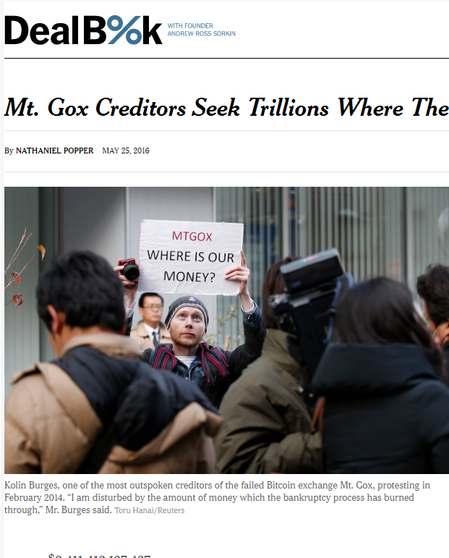
Disadvantages of Custodial Wallets
Your money could be
stolen by hackers
lost or stolen by bankers
confiscated by the government
Notes:
Tabloid scandals and mysteries abound. Mt Gox, a Japanese site that acted as a bank for Bitcoin holdings' seems to have “lost”, somehow, about $600 M of depositor’s money, all in Bitcoin. It has never been explained whether this money was stolen, whether the keys were simply lost, or whether something more complicated happened.

Slide 33
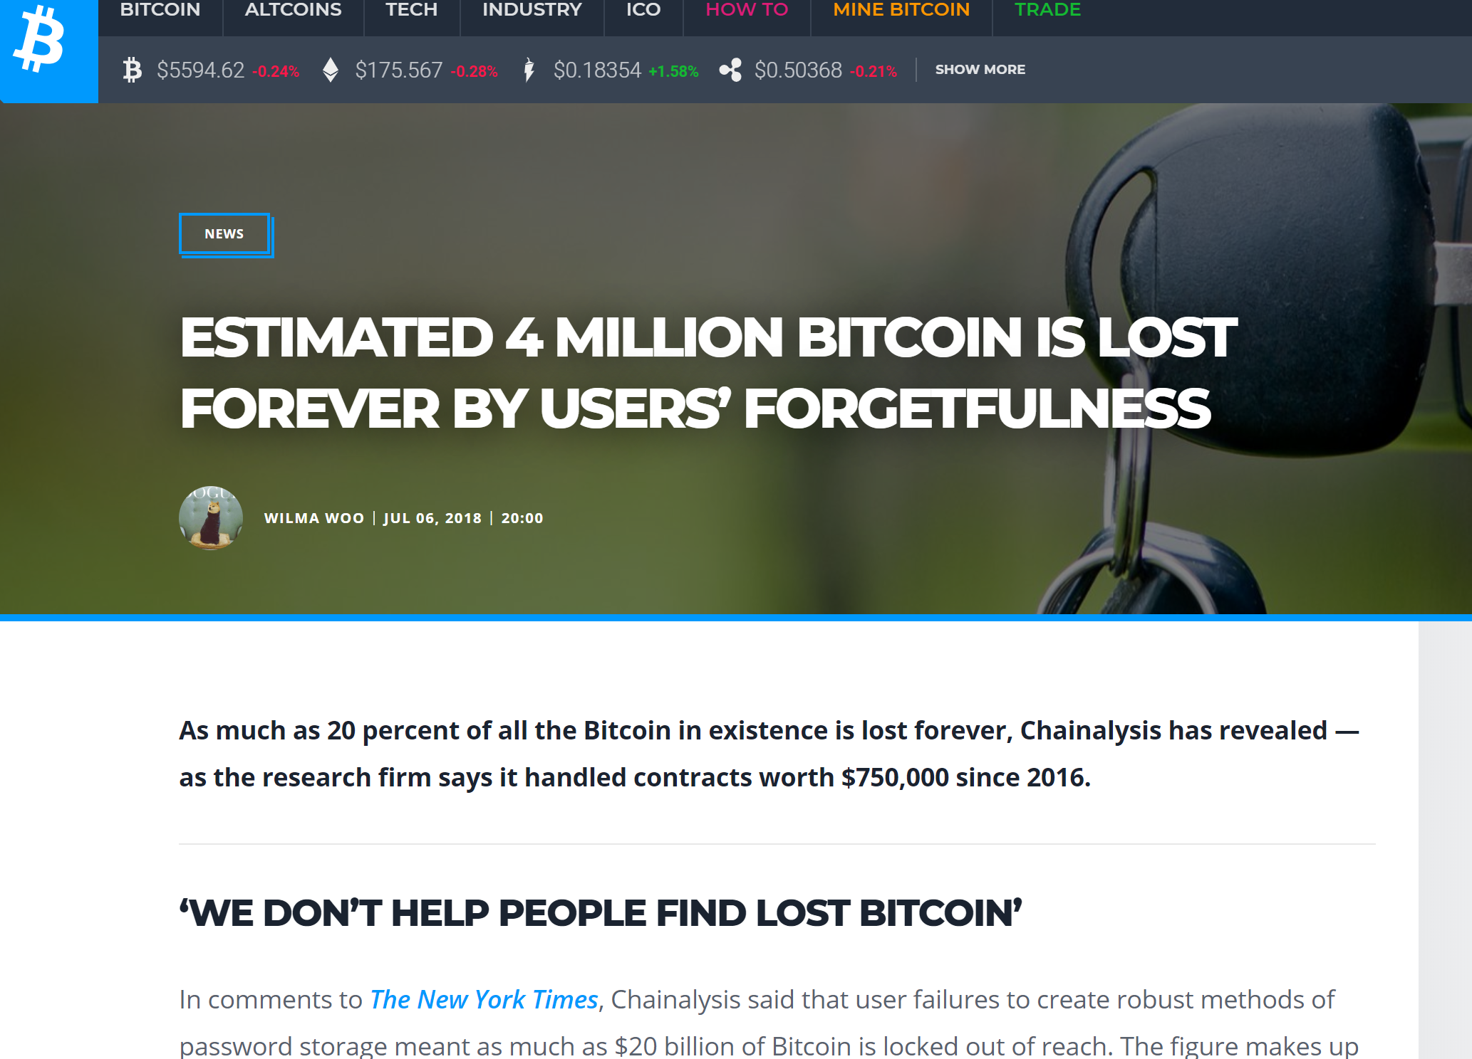
Advantages Non-Custodial
Disadvantages of Non-Custodial Wallets
People are idiots

Slide 34
Custodian by Accident?
Even self-custodial wallets need to provide key-management software
Be careful not to become custodial and regulated by mistake!

Slide 35
SEC Definition
An advisor has custody when she …
has possession of client funds or securities, even briefly,
If the advisor has power to misuse …
Inadvertent possession OK if returned in 3 business days
If you can steal or misuse it, you have custody!

Slide 36
SEC Example
Advisor holds check …
Drawn by client ….
Payable to third party
Not custody!

Slide 37
Atomic Swap?
Controlled by smart contracts
at party & counterparty
No intermediate can steal assets
Like exchanging two checks, each addressed to other party
No custodian?

Slide 38
Peer-to-Peer
Transaction forwarded from one node to another?
Intermediate cannot abuse funds
Dropping message not considered abuse?
No custodian?

Slide 39
Public Transactions
Auditable nature of blockchain makes fraud very hard
Does this mean no custody?
Unclear, probably not.

Slide 40
When Does Custody Happen?
Suppose an exchange guarantees …
funds will be available within “15 minutes of being received”
Given confirmation ambiguity …
when is an asset considered to be received?
Exchange needs explicit policy (like 6 confirmations)

Slide 41
Inadvertent Funds Receipt
Anyone can initiate a transaction to a public address
But sender’s address known
Adviser must return funds within “3 business days”
OK to deduct on-chain fees
But not advisor fees! (Subject to abuse)

Slide 42
Another SEC Example
An advisor has custody if …
It has the authority to withdraw funds or securities from a client's account
Including charging fees …
Or indirect authority to obtain possession
Such as power of attorney, partnership

Slide 43
Custody as Key Management
An advisor not custodian if …
It never has access to clients’ public keys?
What about sharded keys …
Kept by distinct advisors?
Provided only for authorized trades?

Slide 44
Smart Contracts as Custodians?
Client places funds in escrow …
Controlled by smart contract
“Invest in Tesla if stock falls below trigger price.”

Slide 45
Smart Contracts as Custodians?
Who, if anyone, is the custodian?
The contract?
Not a legal entity

Slide 46
Smart Contracts as Custodians?
Who, if anyone, is the custodian?
The contract author?
Not if author cannot control funds after-the-fact
Important: contract should be open source!
Otherwise trust implies custody?

Slide 47
Smart Contracts as Custodians?
Who, if anyone, is the custodian?
The contract author?
Yes, if author can withdraw funds
Yes, if author can change code to withdraw funds
Contract details matter!

Slide 48
Key sharding: 2 out of 3
key
shard
shard
shard

Slide 49
Key sharding: 2 out of 3
One key by itself is useless

Slide 50
Key sharding: 2 out of 3
Any 2 out of 3 unlocks funds
Any 2 our of 3 unlocks funds
BOOM!

Slide 51
Operational Independence
Informally: one cannot influence the other
Financial separation
No personal links
Involved legal definition

Slide 52
2/3 Key Sharding
As long as any pair is operationally independent …
Shard holders not custodians
Because no danger of collusion to abuse funds
But if not operationally independent, they are custodians

Slide 53
m/n Key Sharding
As long as no group of m fails to be operationally independent …
Shard holders not custodians
Because no danger of collusion to abuse funds
But if group of m not operationally independent,
they are custodians

Slide 54
Nevertheless
Whoever assembles enough shards to execute transaction …
Becomes a custodian
Conjecture: unless public blockchain makes abuse impossible?
Until those shards are destroyed
Do you need to prove destruction?

Slide 55
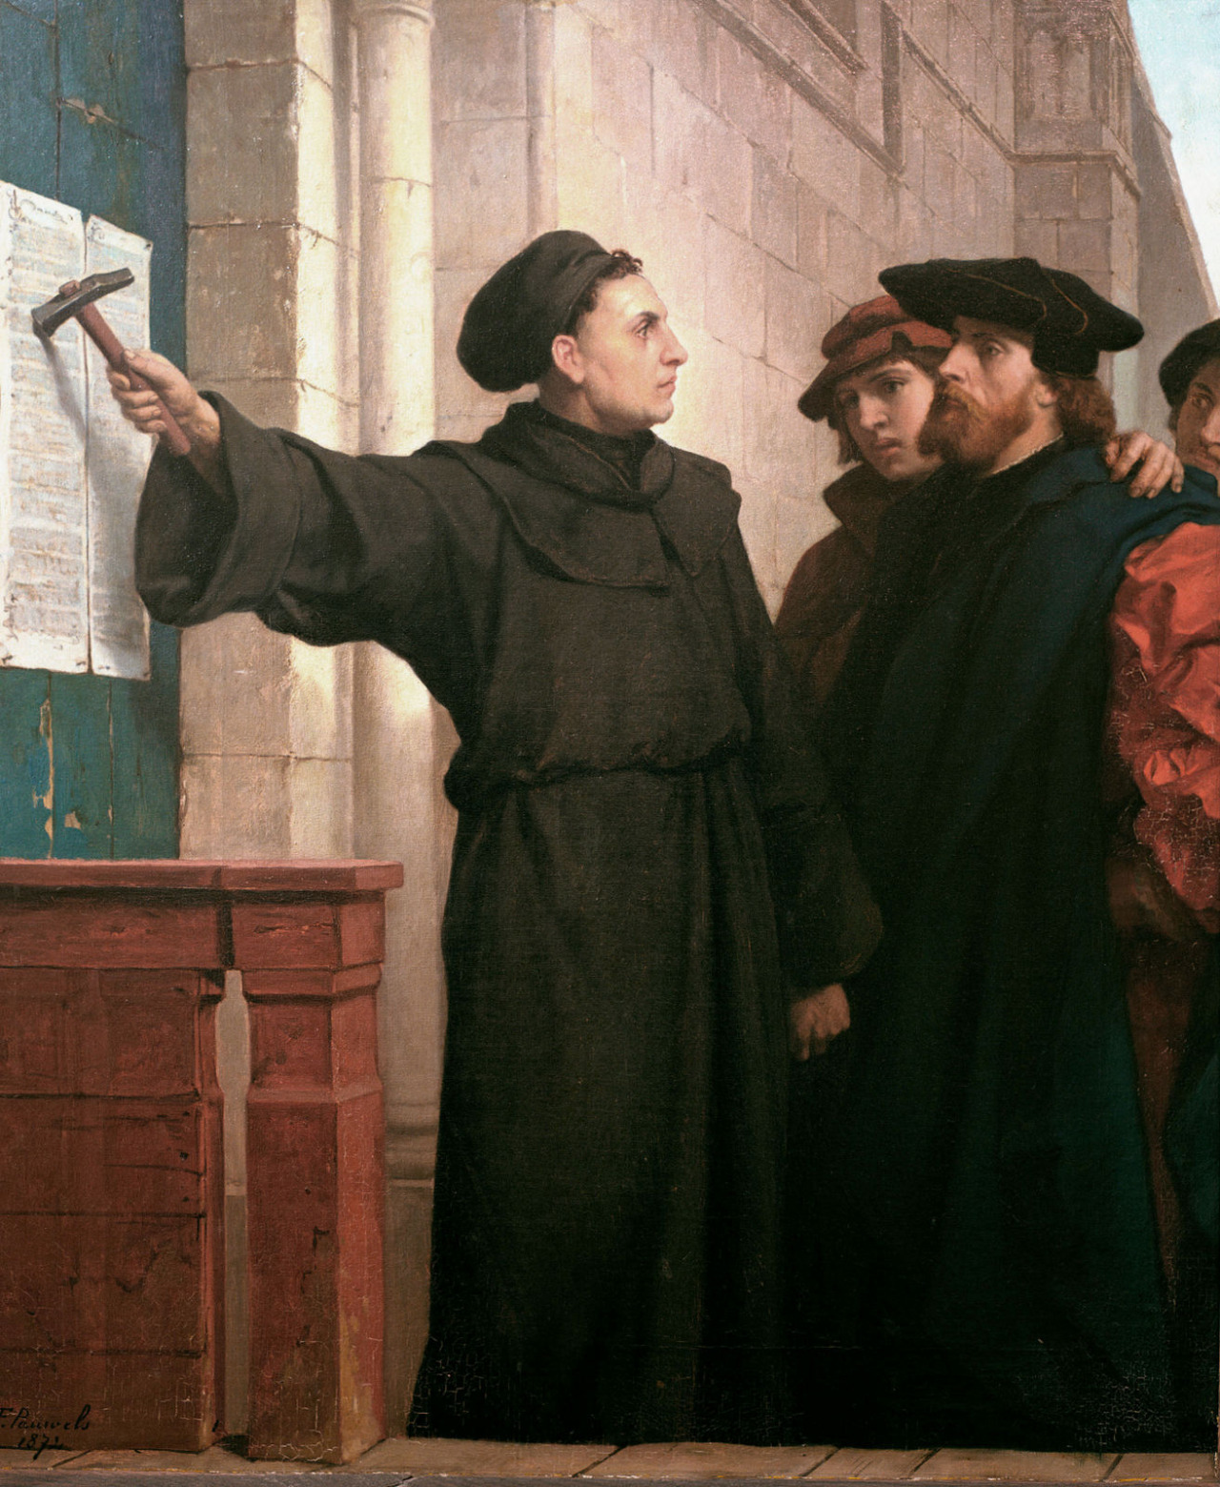
Ideas we covered in this lecture
Regulation for Good & Evil
Securities
Commodities
ICOs
Custody

Slide 56
Title
one
two
three
BOOM!
four
five

