Slide 1
CS1951 L
Blockchains & Cryptocurrencies
Spring 2024
Lecture 22
DeFi
Maurice Herlihy
Brown University

Slide 2
Decentralized Finance (DeFi)
Higher-Level Financial Protocols
Built on Blockchain
Smart Contracts
“programmable money”

Slide 3
Decentralized Finance (DeFi)
Derivatives
Payment Networks
Stable Coins
Exchanges
Loans

Slide 4
Exchanges
Trade one asset for another
Want good liquidity
Meaning traders don’t wait around
Want low slippage
Meaning purchase shouldn’t move price

Slide 5
Centralized Exchanges
Convenient
Good Liquidity
Low Slippage
Secure, compliant, etc.
See CoinBase, BitFinex, etc.

Slide 6
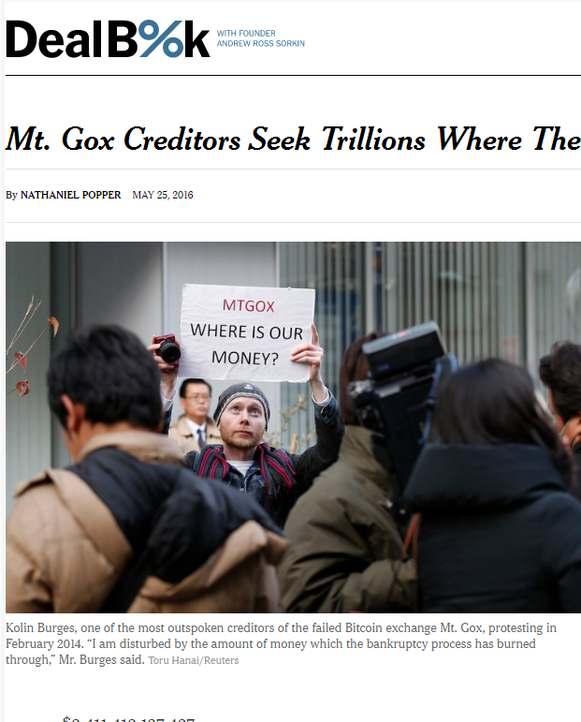
Also Centralized Exchanges
Notes:
Tabloid scandals and mysteries abound. Mt Gox, a Japanese site that acted as a bank for Bitcoin holdings seems to have “lost”, somehow, about $600 M of depositor’s money, all in Bitcoin. It has never been explained whether this money was stolen, whether the keys were simply lost, or whether something more complicated happened.

Slide 7
Order Book: Guilder vs Florin Tokens
Sell offers
Guilder Token | Price
1 | @1.21
1 | @1.23
10 | @1.26

Slide 8
Order Book: Guilder vs Florin Tokens
I want 3 Guilder @ ≤1.25
Guilder Token | Price
1 | @1.21
1 | @1.23
10 | @1.26

Slide 9
Order Book: Guilder vs Florin Tokens
I want 3 Guilder @ ≤1.25
Guilder Token | Price
1 | @1.21
1 | @1.23
10 | @1.26
sold
sold
Too expensive

Slide 10
Order Book: Guilder vs Florin Tokens
I want 3 Guilder @ ≤1.25
Guilder Token | Price
1 | @1.21
1 | @1.23
10 | @1.26
sold
sold
Too expensive
My slippage is price difference between first @1.21 and last @1.23,

Slide 11
Order Book: Guilder vs Florin Tokens
I want 3 Guilder @ ≤1.25
Guilder Token | Price
1 | @1.21
1 | @1.23
10 | @1.26
sold
sold
Too expensive
My slippage is price difference between first @1.21 and last 1@1.23,
My liquidity is poor because I am still waiting for 3rd purchase

Slide 12
AMMs

Slide 13
Automated Market Maker
Trade between …
2 or more liquidity pools
Using mathematical formula
No waiting, no theft, no KYC/AML …

Slide 14
Liquidity Providers
Liquidity Providers lend assets to pool
In return for shares in AMM
Earn Fees
Governance
Can add or remove liquidity

Slide 15
Constant-Product AMM
guilder
Two liquidity pools
Florin & guilder
$$x y=1$$
States lie on curve
florin

Slide 16
Constant-Product AMM
guilder
$$y= \frac{1}{x}$$
florin

Slide 17
Constant-Product AMM
guilder
½ florin
(½,2)
2 guilder
$$y= \frac{1}{x}$$
2
State lies on curve
½
florin

Slide 18
Trader converts 1 florin to guilder
guilder
(½,2)
1 florin in
3/2
florin

Slide 19
Trader converts 1 florin to guilder
guilder
(½,2)
1 florin in
4/3 guilder out
(3/2,2/3)
3/2
florin

Slide 20
Fees
Each trade incurs fees
Usually added to liquidity pool
Eventually returned to LPs
0.3% for Uniswap
Ignoring for now

Slide 21
Arbitrage
guilder
AMM state
Actual market state
florin

Slide 22
Arbitrageur profits by correcting exchange rate
guilder
Risk-free profit
florin

Slide 23
Arbitrage
AMM can’t read market rates
But Arbitrageurs will ensure accuracy
AMM can act as price oracle?
Mostly yes, but open to manipulation …

Slide 24
Price
guilder
dx
dy
florin

Slide 25
Spot price is (negative of) derivative
guilder
$$\frac{∂y}{∂x}$$
florin

Slide 26
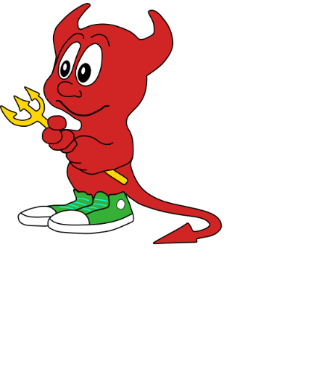
Put 1 Florin!
Front-Running
guilder
Should return 1.3333 guilders
Delayed!
(½,2)
florin

Slide 27
Put 1 Florin!
Front-Running
Expecting 1.3333 guilders
Put 10 Florins!
guilder
Returns 1.9047 guilders
Front run!
(½,2)
florin

Slide 28
Put 1 Florin!
Front-Running
Expecting 1.3333 guilders
Put 10 Florins!
guilder
Got 1.9047 guilders
Returns 0.0082 guilders
(½,2)
Delayed
put happens
florin

Slide 29
Put 1 Florin!
Front-Running
Expecting 1.3333 guilders
Put 10 Florins!
guilder
Got 1.9047 guilders
Cashing in!
(½,2)
Got 0.0082 guilders?
Put back my guilders!
Got 10.9979 florins
florin

Slide 30
Front-Running
I got 1.3250 fewer guilders than expected?
guilder
I got risk-free profit of 0.9979 florins!
florin

Slide 31
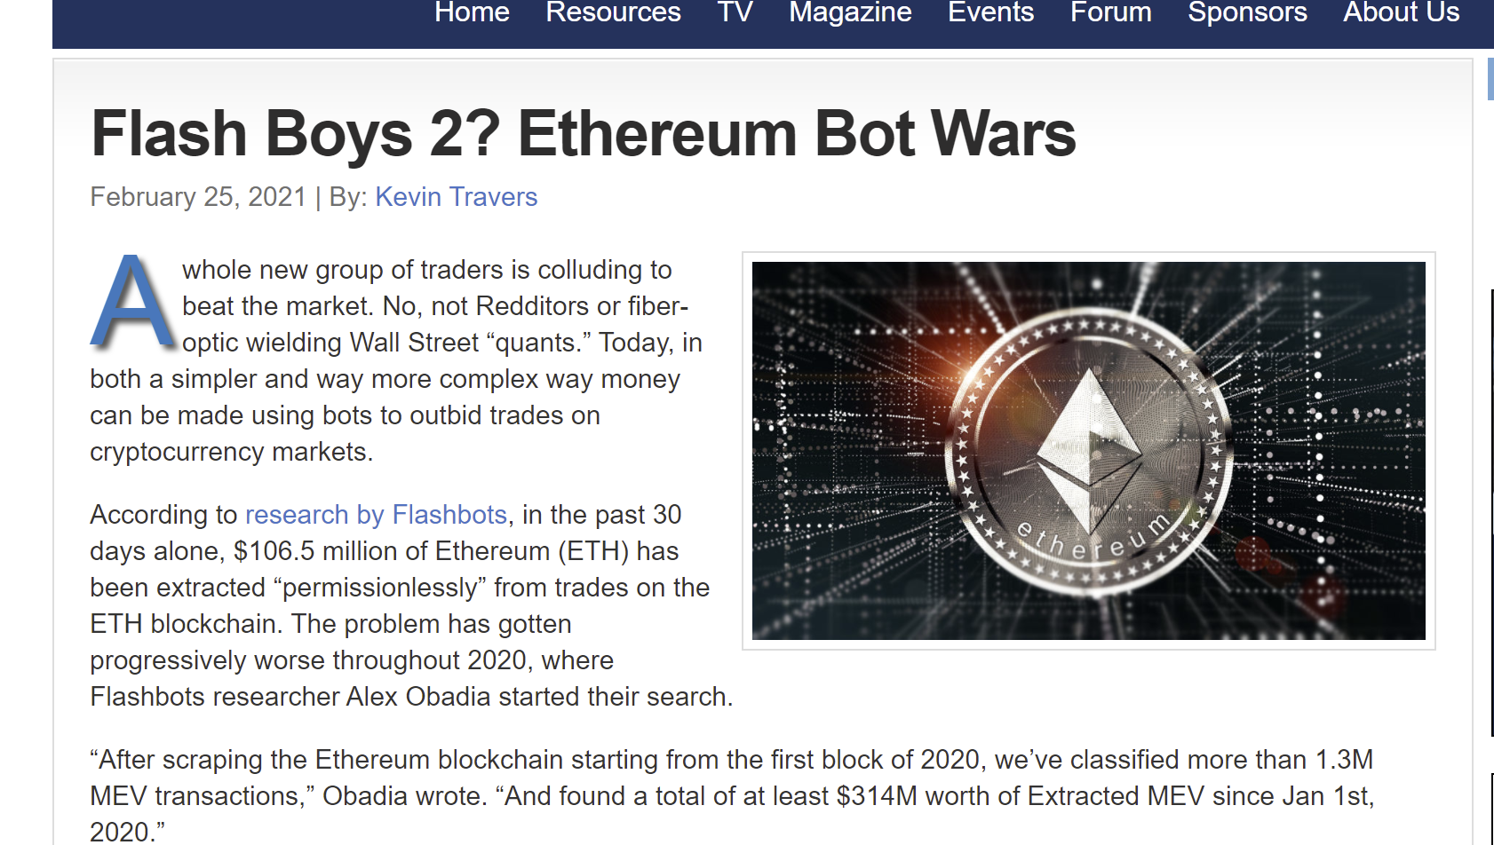
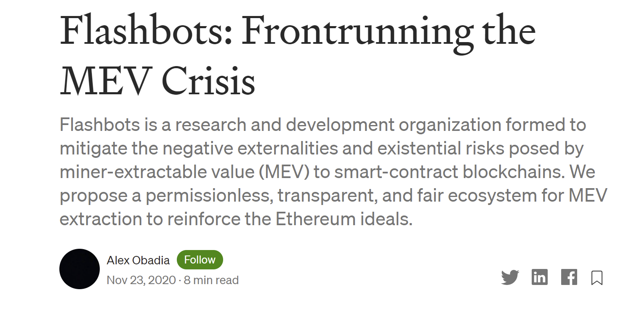
This Happened

Slide 32
$$y=f(x)$$
General AMMs
guilder
Which functions make sense?
florin

Slide 33
$$y=c x$$
Linear AMMs
guilder
Constant price
No slippage
What if price changes?
One pool emptied
florin

Slide 34
$$y=f(x)$$
General AMMs
guilder
$f(x)$should be continuous
Pool sizes don’t change abruptly
florin

Slide 35
$$y=f(x)$$
General AMMs
guilder
$f(x)$should be smooth
Prices don’t change abruptly
florin

Slide 36
$$y=f(x)$$
General AMMs
guilder
$f(x)$should be strictly decreasing
Adding florins shouldn’t create more guilders
???
put
florin

Slide 37
$$y=f(x)$$
General AMMs
guilder
$f(x)$should be convex …
Meaning tangent line …
Below the curve
florin

Slide 38
$$y=f(x)$$
Convexity
Market price

Slide 39
$$y=f(x)$$
Convexity
$$\text{Alice} \text{pays} \text{AMM}\text{ ...}$$
put
Market price

Slide 40
$$y=f(x)$$
Convexity
$$\text{Alice} \text{pays} \text{AMM}\text{ ...}$$
AMM tangent slope = market price
put
get
Market price

Slide 41
$$y=f(x)$$
Convexity
$$\text{Alice} \text{pays} \text{AMM}\text{ ...}$$
AMM tangent slope = market price
Large buy gets less than market price
put
get
Market price
Slippage works against Alice
get at market price

Slide 42
Non-Convexity
Market price

Slide 43
Non-Convexity
put
get

Slide 44
Non-Convexity
put
get
at market price

Slide 45
Non-Convexity
put
AMM yields better than market
get
at market price
Runaway effect!
Traders buy up undervalued assets

Slide 46
$$y=f(x)$$
General AMMs
guilder
$f(x)$should be expressive
Adapts to any market price …
$\frac{∂f}{∂x}\left(x\right)$assumes every value between -∞ to 0
No linear AMMs
florin

Slide 47
Relative value of florin vs guilder?
Valuation
$t$ florin worth$(1−t) \text{guilder}$
Where $0≤t≤1$
Every valuation is a point in unit interval
florin
guilder
$$t$$
$$1−t$$
0
1

Slide 48
Valuation vs Price
$$\frac{df(x)}{dx}=\frac{t−1}{t}$$
florin
guilder
$$t$$
$$1−t$$
0
1

Slide 49
Stable Point for a valuation
$(x,y)$ is a stable point for valuation $(t,1−t)$ …
If an arbitrageur …
Makes no profit by moving away from $(x,y)$
If function satisfies our properties …
Every valuation has unique stable point

Slide 50
Sequential Composition
Given
AMM A: florins → guilders …
AMM B: guilders → francs …
Construct:
AMM C: florins → francs

Slide 51
Sequential Composition Example
guilder
$$y= \frac{p}{x}$$
$$(a,\frac{p}{a})$$
Constant-product function
florin
Initial state

Slide 52
guilder
$$y= \frac{p}{x}$$
Put florins in AMM A
$$(a,\frac{p}{a})$$
Get back guilders
florin

Slide 53
guilder
$$y= \frac{p}{x}$$
franc
$$z= \frac{q}{y}$$
$$(a,\frac{p}{a})$$
$$(b,\frac{q}{b})$$
florin
guilder
Constant-product function
Initial state

Slide 54
guilder
$$y= \frac{p}{x}$$
franc
$$z= \frac{q}{y}$$
$$(a,\frac{p}{a})$$
$$(b,\frac{q}{b})$$
florin
guilder
Put guilders in AMM B
Get back francs

Slide 55
guilder
$$y= \frac{p}{x}$$
franc
$$z= \frac{q}{y}$$
$$(a,\frac{p}{a})$$
$$(b,\frac{q}{b})$$
florin
guilder
Function, but not constant-product
franc
$$z=\frac{q}{b+\frac{p}{a}−\frac{p}{x}}$$
florin

Slide 56
guilder
$$y= \frac{p}{x}$$
franc
$$z= \frac{q}{y}$$
$$(a,\frac{p}{a})$$
$$(b,\frac{q}{b})$$
florin
guilder
franc
$$z=\frac{q}{b+\frac{p}{a}−\frac{p}{x}}$$
florin

Slide 57
Parallel Composition
Given
AMM A: florins → guilders …
AMM B: florins → guilders …
Construct:
AMM C: florins → guilders

Slide 58
guilder
$$y= \frac{p}{x}$$
guilder
$$y= \frac{q}{x}$$
$$(a,\frac{p}{a})$$
$$(b,\frac{q}{b})$$
florin
florin
Different prices …
Different slippage
Let’s buy guilders with florins …
How to split between them?

Slide 59
Parallel Composition Algorithm
Buy from one with best price …
Until slippage causes other’s price to be better …
Then switch …
Repeat as needed

Slide 60
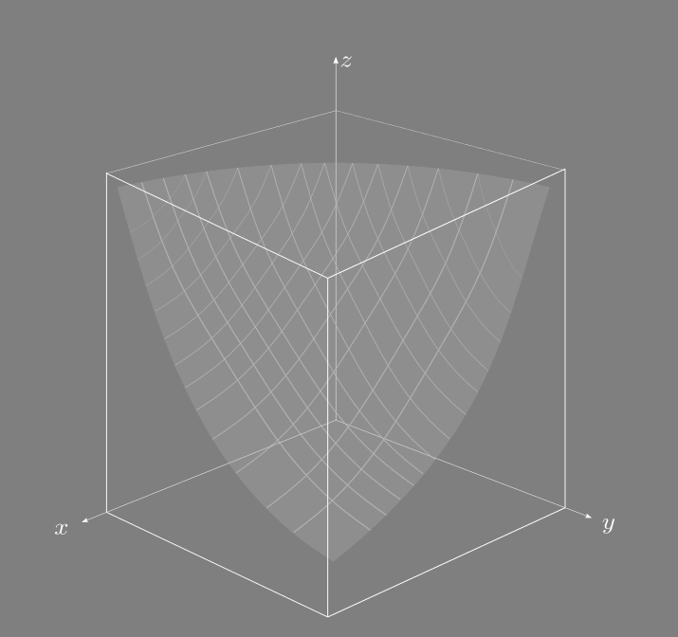
AMMs Can Manage > 2 Assets
Math is more complex ….
But most ideas generalize

Slide 61
Flash Loans

Slide 62
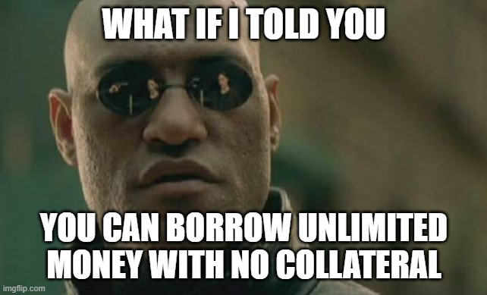

Slide 63
Flash Loans
Start Transaction
Borrow money
Go wild
Repay money with interest
Commit Transaction

Slide 64
Flash Loans
Cannot commit if money not repaid!
Start Transaction
Borrow money
Go wild
Repay money with interest
Commit Transaction

Slide 65
Flash Loans
Start Transaction
If you don’t commit, you revert, & never borrowed in first place!
Borrow money
Go wild
Repay money with interest
Commit Transaction

Slide 66
Flash Loans

Slide 67
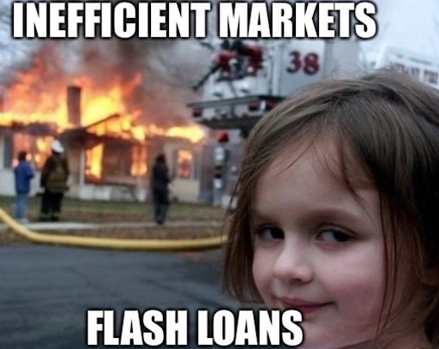

Slide 68
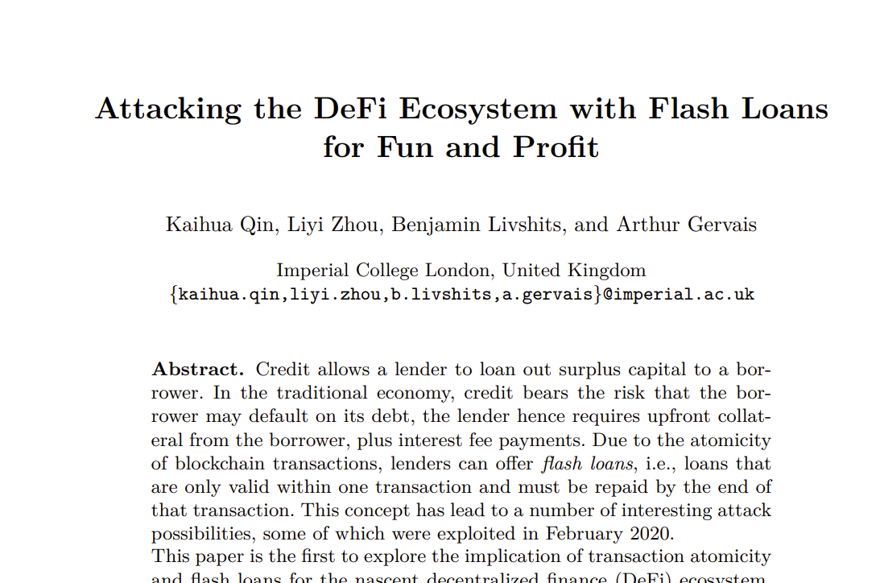

Slide 69
Price Oracles
How do exchanges know market rates?
No trusted 3rd parties
Ask other on-chain DEXs!
But DEX prices can be manipulated …

Slide 70
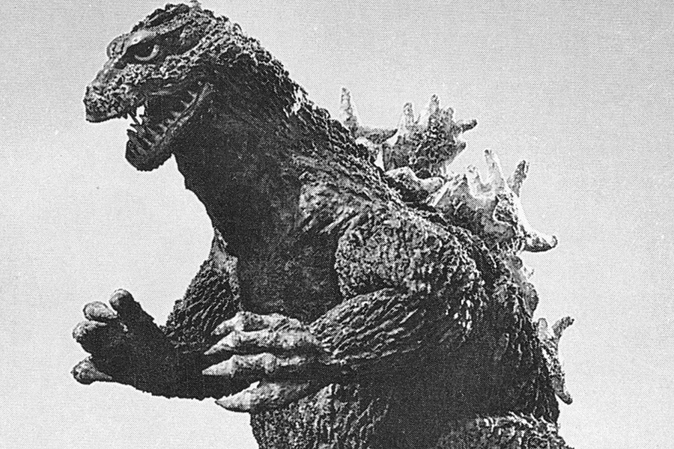
Flash Loan Attack
Borrow ETH on DEX
Convert to sUSD at victim’s Oracle AMMs
Distorting Oracles’ price information
Convert back at Victim at distorted rate
Repay loan
Keep the difference

Slide 71
1 ETH = 1 sUSD
Oracle AMMs
ETH
sUSD
Exchange

Slide 72
1 ETH = 1 sUSD
Flash lend me 1 gazillion ETH
Oracle AMMs
Exchange

Slide 73
1 ETH = 1 sUSD
Oracle AMMs
Owes 1G ETH
Exchange
ETH

Slide 74
1 ETH = 1 sUSD
Hey, Oracles, convert my 1G ETH to sUSD!
Oracle AMMs
Owes 1G ETH
Exchange
ETH

Slide 75
1 ETH = 1 sUSD
2 ETH = 1 sUSD
My purchase was so large it moved the market!
Oracle AMMs
Owes 1G ETH
sUSD
Exchange

Slide 76
1 ETH = 1 sUSD
2 ETH = 1 sUSD
Oracle AMMs
Convert my sUSD to ETH!
Owes 1G ETH
sUSD
Exchange

Slide 77
1 ETH = 1 sUSD
2 ETH = 1 sUSD
Oracle AMMs
Hey oracles, what’s the rate?
Convert my sUSD to ETH!
Owes 1G ETH
sUSD
Exchange

Slide 78
1 ETH = 1 sUSD
2 ETH = 1 sUSD
Oracle AMMs
Here you go, @market rate!
Owes 1G ETH
Exchange
ETH
ETH

Slide 79
1 ETH = 1 sUSD
2 ETH = 1 sUSD
Oracle AMMs
Owes 1G ETH
Exchange
ETH
ETH

Slide 80
1 ETH = 1 sUSD
I repay your flash loan & commit transaction,
keeping the extra ETH
2 ETH = 1 sUSD
Oracle AMMs
Uh, oh …
ETH
Exchange
ETH

Slide 81
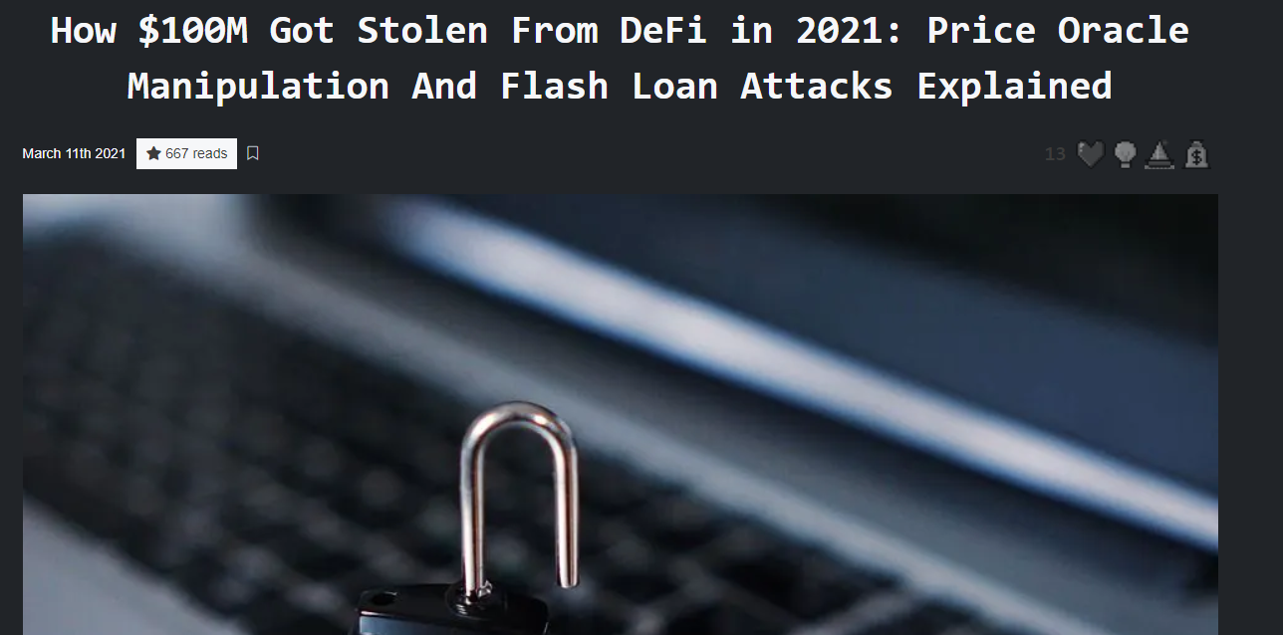
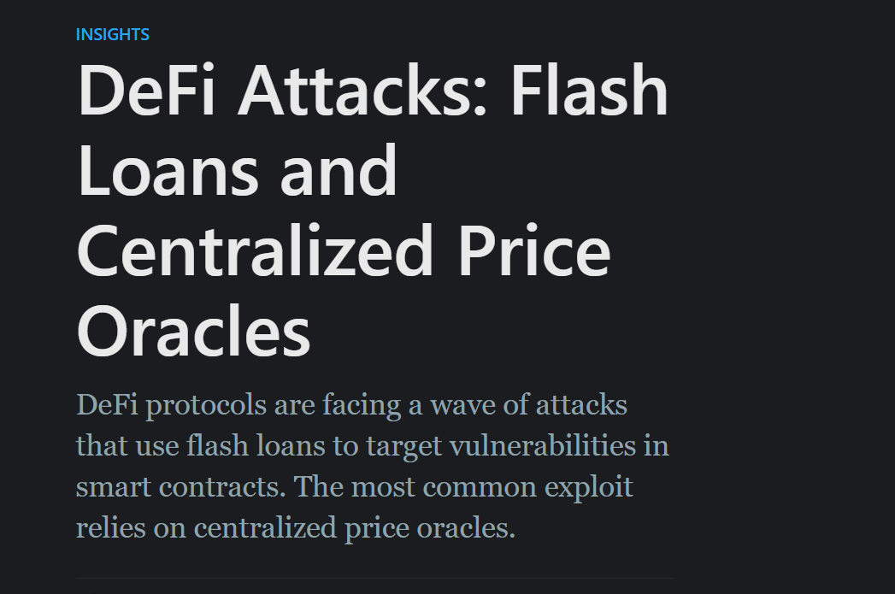
This Happened
18 February 2020
Victim was bZx exchange
Oracles were Uniswap & Kyber Reserve
Attacker’s cost: 118.79 USD fees
Attacker’s profit: 635 thousand USD
Other attacks too ….

Slide 82
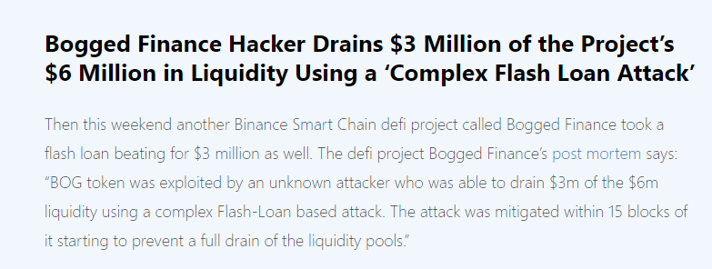

Slide 83
Ideas we covered in this lecture
Exchanges, centralized and decentralized
Order book
AMMs
Constant product
General AMMs
Front-running & Flash loans

