Slide 1
CS1951 L
Blockchains & Cryptocurrencies
Spring 2024
Lecture 20
Light Clients and Wallets
Maurice Herlihy
Brown University

Slide 2
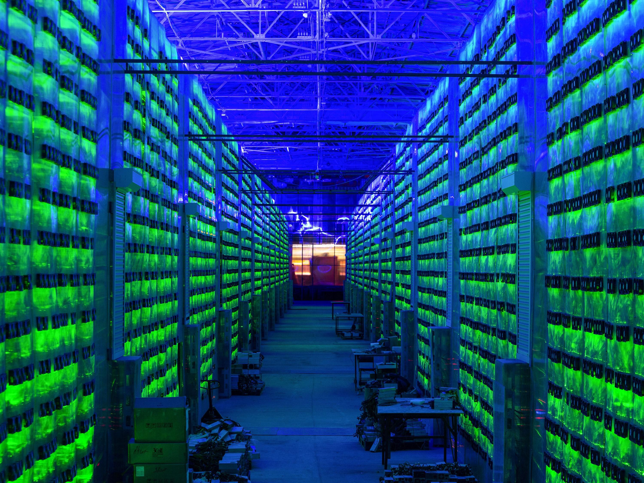
Minimum Bitcoin Full Node
7G disk space, R/W 100 MB/s
2G Ram
400K network connection
200G/month upload, 20G/month download
340/G initial download

Slide 3
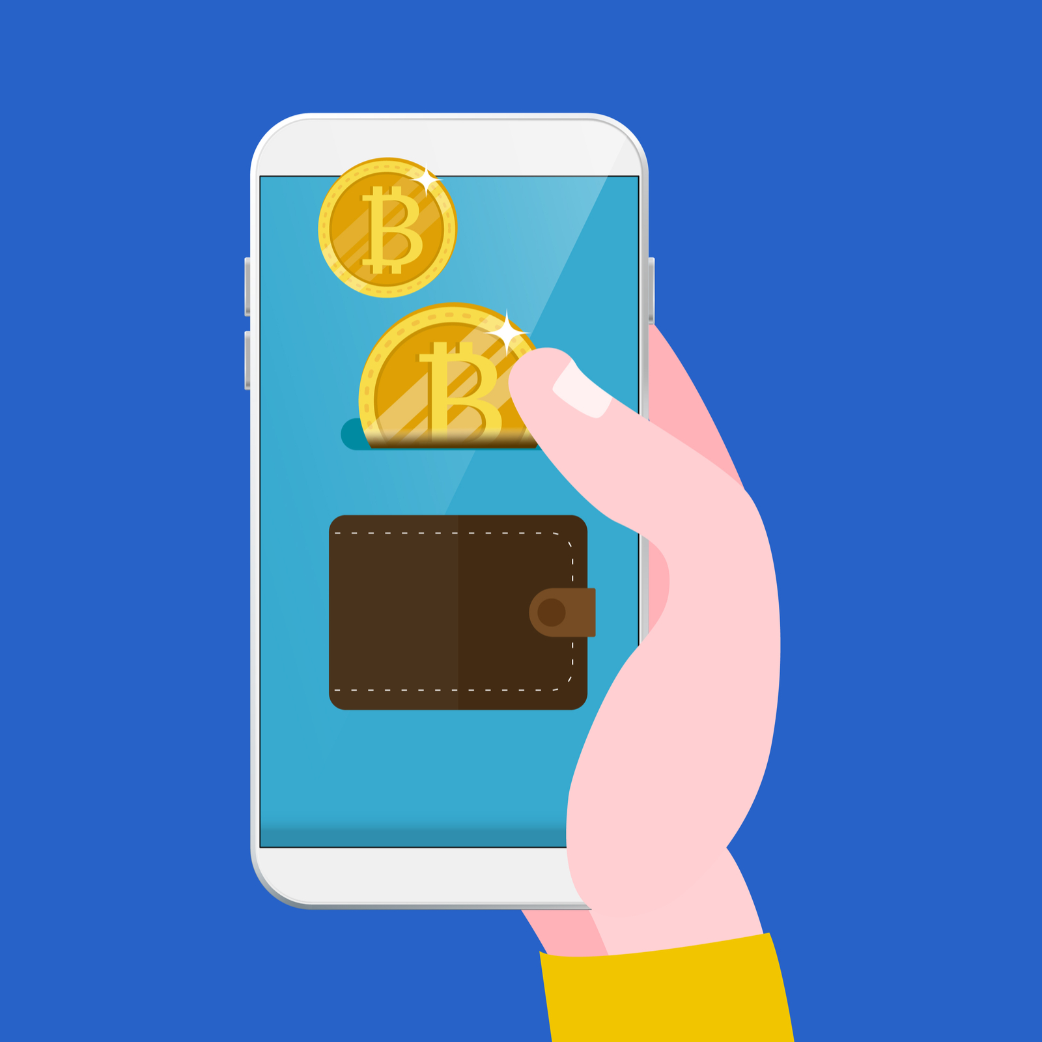
Lightweight Payment Verification (LPV Node)
I’d like to verify incoming payments too!

Slide 4
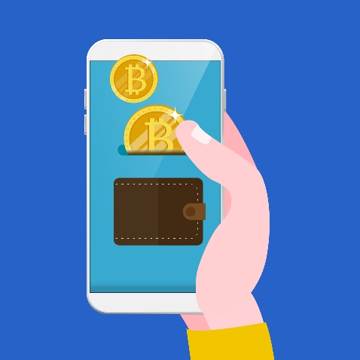
Send me only transactions I care about
Here you go …
(heh-heh)

Slide 5
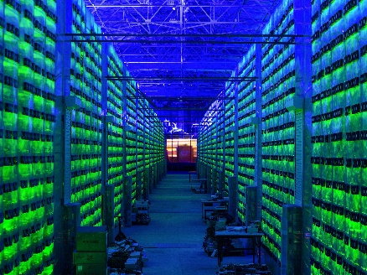
Send me only transactions I care about
Here you go
Here you go
Here you go
Heh-heh ..
Here you go
Here you go
Here you go
Here you go
Heh-heh..

Slide 6
BTC Lightweight node
Mostly just track headers …
header
hash
header
header
header
hash
hash
hash
Much smaller than full blocks
time
Notes:
A Blockchain is just a list, where each element contains a list of events to be recorded, and various cryptographic hashes and signatures. The technical details are not important here.

Slide 7
BTC Lightweight node
header
header
header
hash
hash
hash
Irrelevant children
omitted
I’m of local interest
time
Notes:
A Blockchain is just a list, where each element contains a list of events to be recorded, and various cryptographic hashes and signatures. The technical details are not important here.

Slide 8
Only transactions for addresses A₁,…,A₁₀₀₀
Too much information!

Slide 9
Bloom Filters
Compact set representation
Fast membership test
Randomization via hashes
False Positives: OK
False Negatives: Not OK

Slide 10
(push)

Slide 11
Bloom Filter
h

Slide 12
Testing Membership
Yes, maybe…
member
h

Slide 13
Testing Membership
No!
member
h

Slide 14
False Positives
Yes, maybe…
member
h

Slide 15
Bloom Filter v2
h₁
h₂

Slide 16
Testing Membership
Yes, maybe…
member
h₁
h₂

Slide 17
Testing Membership
No
member
h₁
h₂

Slide 18
False Positives
Yes, maybe…
member
h₁
h₂

Slide 19
(pop)

Slide 20
Only transactions matching this compact Bloom Filter
Much smaller,
more private because of false positives

Slide 21
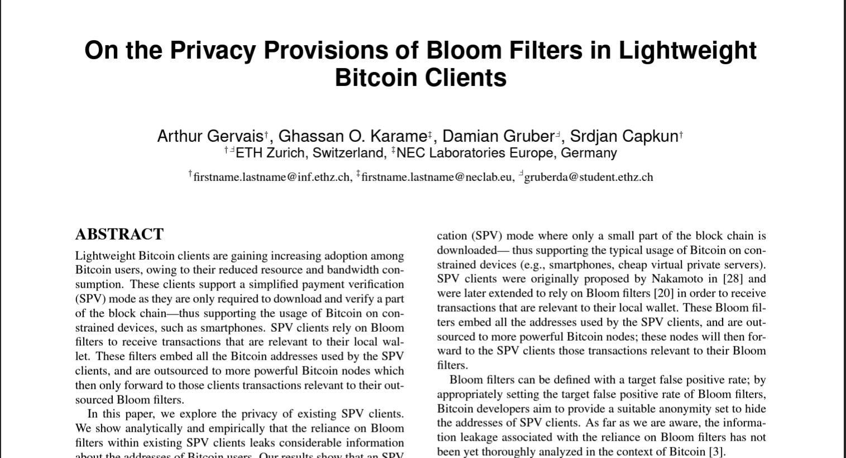
Bloom Filter Privacy?
Unfortunately, not so private
Small number of addresses
⇒
few false positives, addresses leaked
Multiple filters from same client
⇒
easy to link filters, find addresses

Slide 22
Some Examples

Slide 23
Ethereum’s Geth
Less than full-node resource consumption
Arguably, not all that light
(Raspberry Pi OK, Cellphone less so)
Slow initialization phase from
distributed hash table
Plans for lighter client when PoS arrives

Slide 24
Celo Plumo Light Client
Celo = PoS chain with validators, not miners
LC downloads validator set not block hdrs
Download once per day, not every block
Compact BLS signatures (aggregated)
Much better than LPV, but …
Sync time continues to increase

Slide 25
Celo’s Plumo Light Client
What if we could checkpoint reliably?
ZK-SNARKs!
Verify transition from epoch X to X+Y …
At latest epoch, just download block headers
Setup requires a ceremony

Slide 26
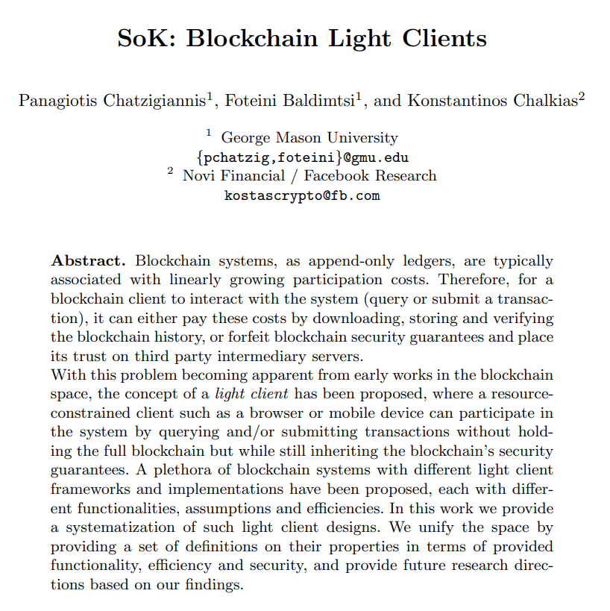
To Learn More

Slide 27
wallets

Slide 28
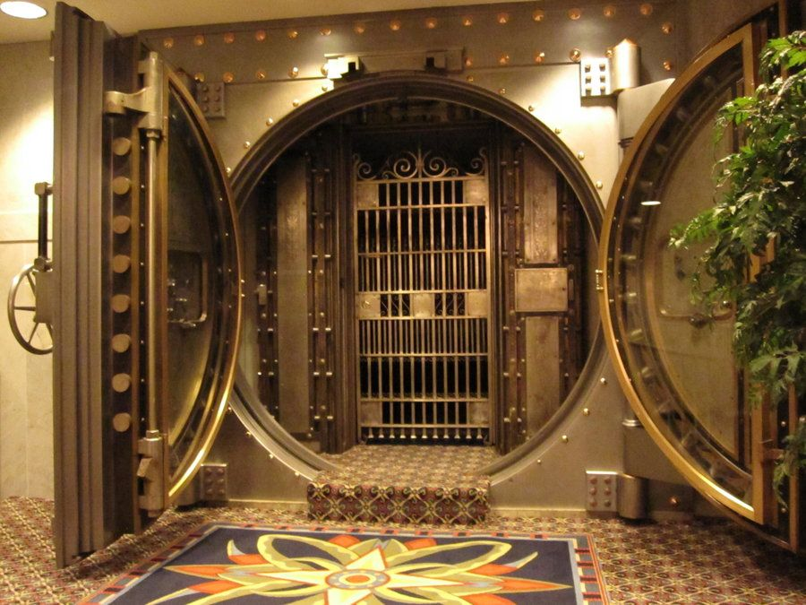
Where do
Stock certificates, gold, cash, etc.
Live?
In custody of bank vaults, deposit boxes, etc.
To secure them from theft

Slide 29
Where do
Bitcoins, Ether, Algos, Litecoin, etc.
Live?
On the blockchain!
(OK, that was a trick question)

Slide 30
Where do
The keys that control cryptocurrencies.
Live?
In wallets!
To secure them from theft
Interact with blockchains & exchanges

Slide 31
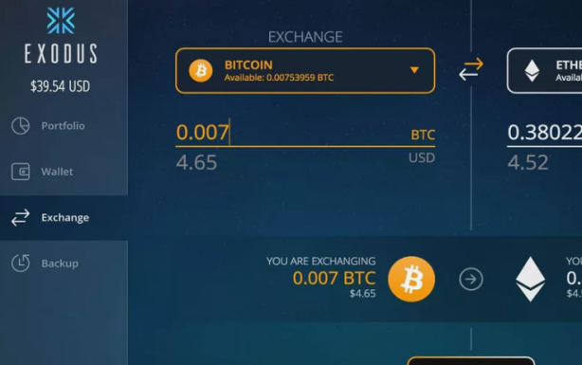
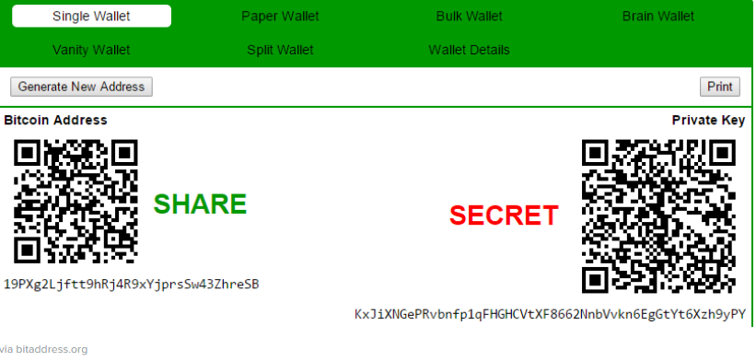
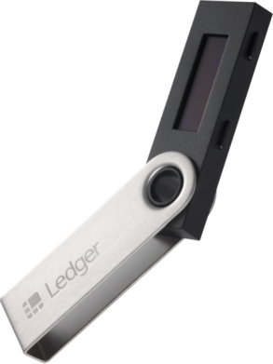
Kinds of Wallets
Software
Paper
Hardware

Slide 32
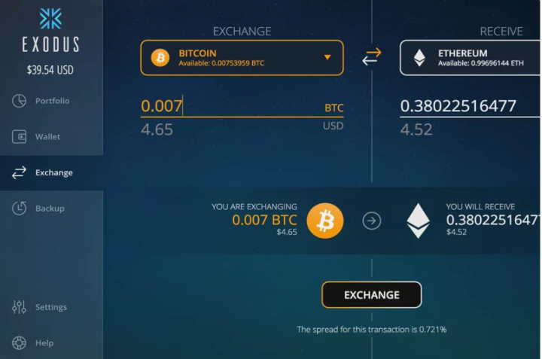
Desktop Wallets
Advantages:
Private keys secured on your computer
User-friendly interface
Easy to manage multiple currencies

Slide 33
Desktop Wallets
Disadvantages:
Only as secure as your computer
If your computer crashes, you lose

Slide 34
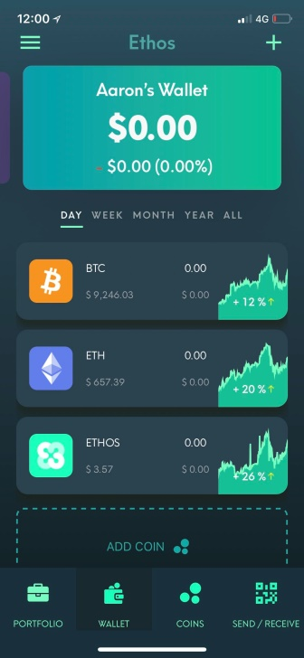
Mobile Wallets
Advantages:
Easy to use for day-to-day transactions
Most use 2-factor authentication, etc.

Slide 35
Mobile Wallets
Disadvantages:
More vulnerable to hacking than desktop
Small screen awkward for complex transactions

Slide 36
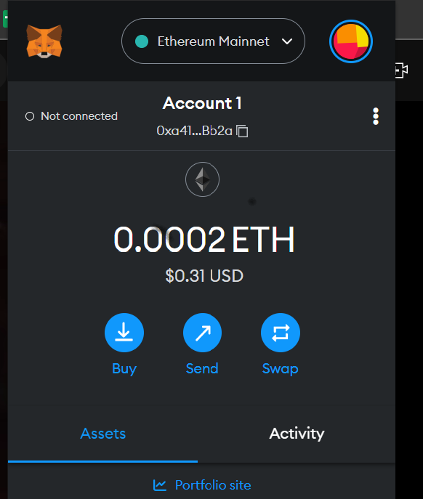
Web Wallets
Advantages:
Easy to use, accessible anywhere
Multi-device support
Automated backup

Slide 37
Web Wallets
Disadvantages:
Connected to Internet, less secure
Keys controlled by 3rd party
Depend on service provider

Slide 38
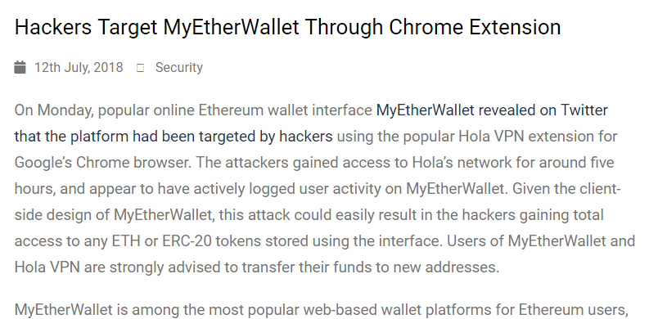
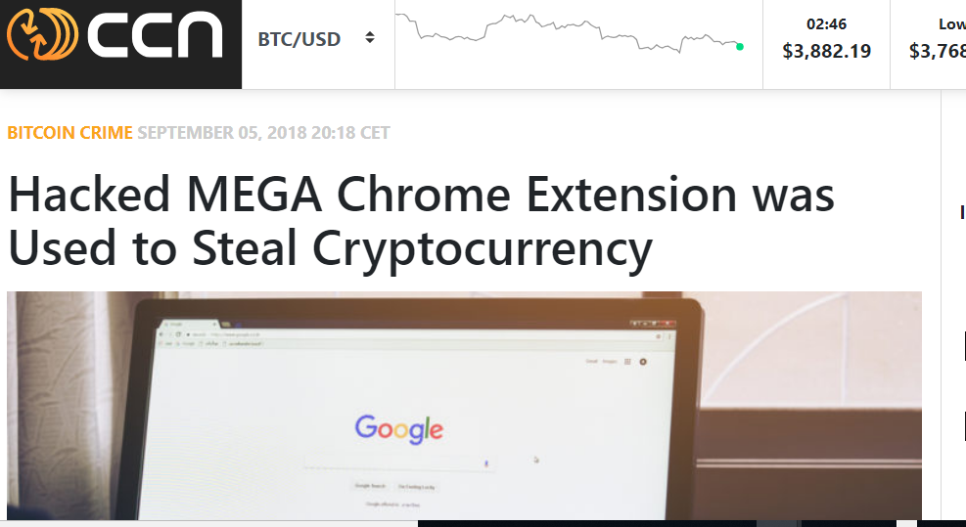
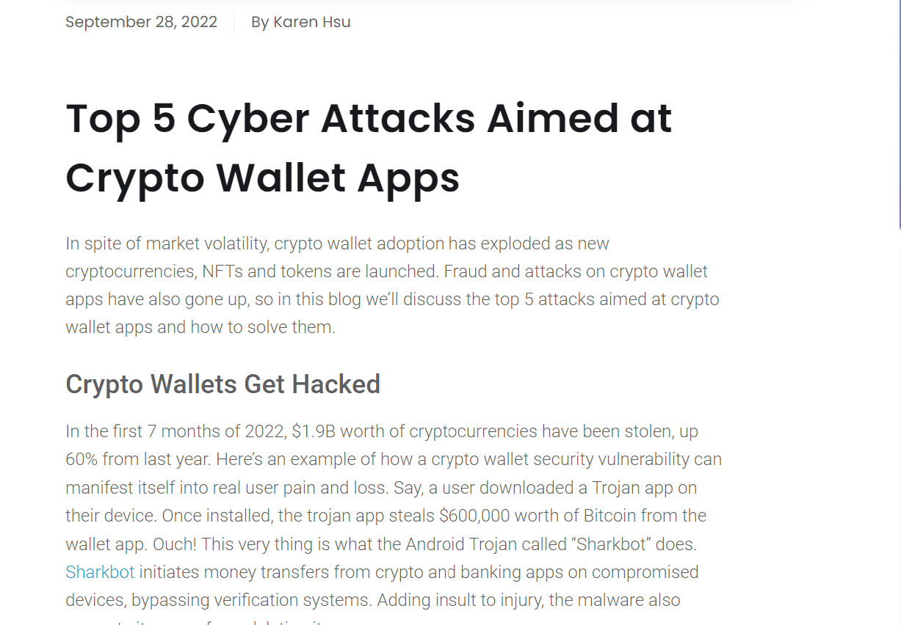

Slide 39
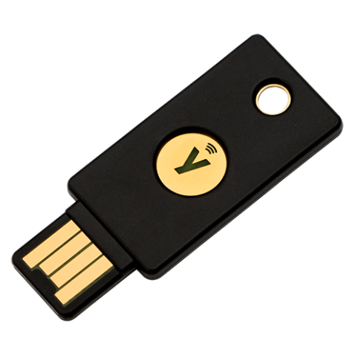
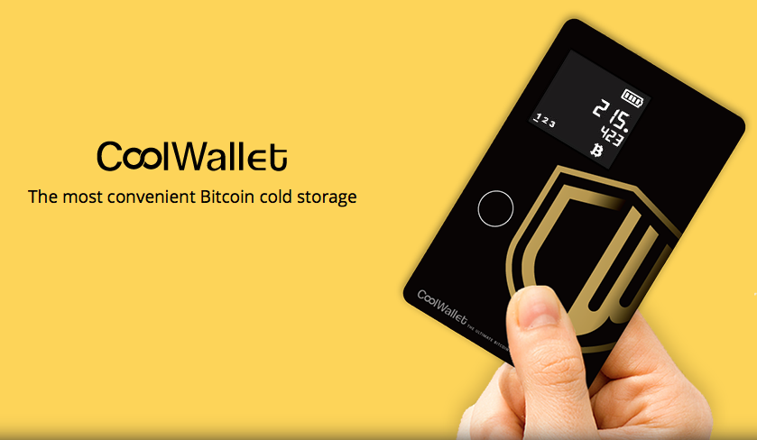
Hardware Wallets
Advantages:
Very secure, “air gap”
Portable
You have complete control

Slide 40
Hardware Wallets
Disadvantages:
Expensive
Terrible user interfaces
Loss or damage to device?

Slide 41
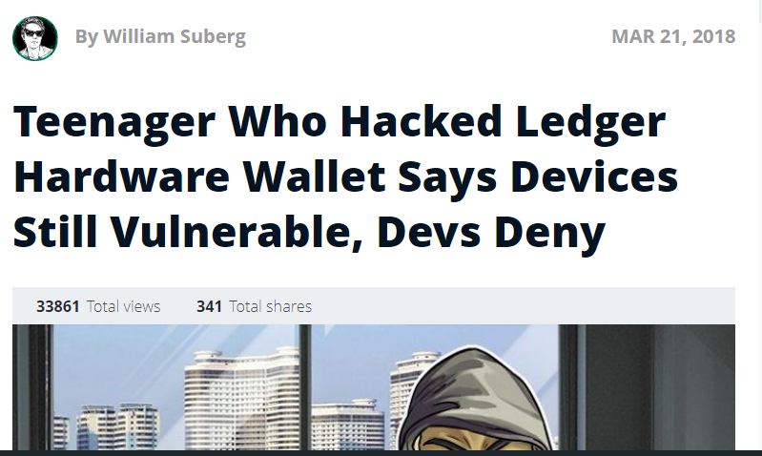
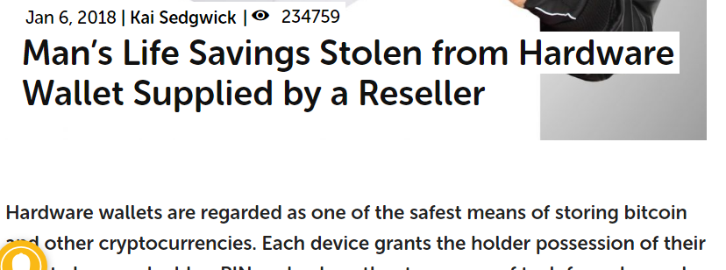
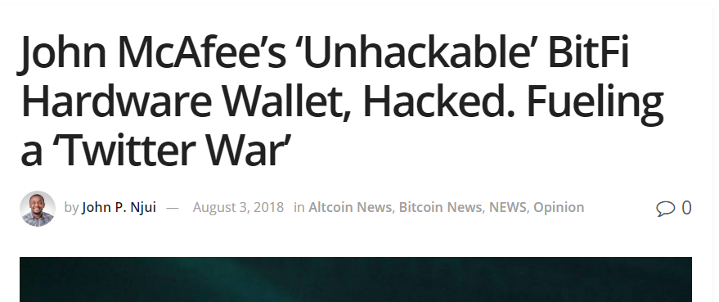
Mixed History …

Slide 42
Paper Wallet
Not recommended for red-green color-blind
Most secure
Easy to create, print
Easy to secure (in a safe place)
Notes:
Not good if you are red-green color blind.

Slide 43
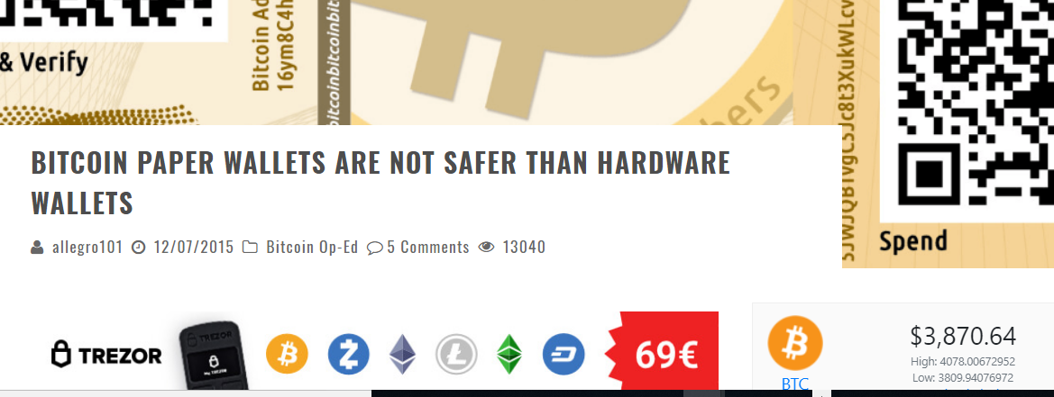
Well, Actually …
Inconvenient to use
Physical damage, loss
Still vulnerable when created or used
Notes:
Even paper wallets have their skeptics. One issue is that if you create the paper wallet with software, that software could leak your keys, or substitute its own keys. Caveat emptor!

Slide 44
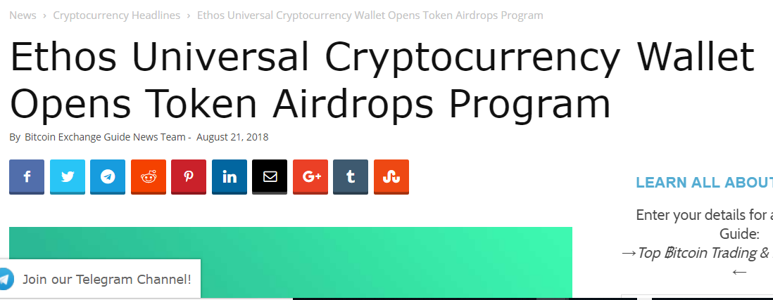
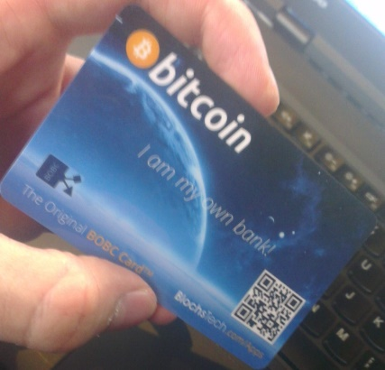
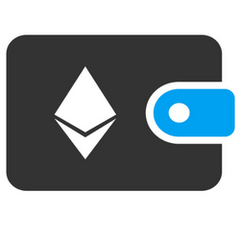
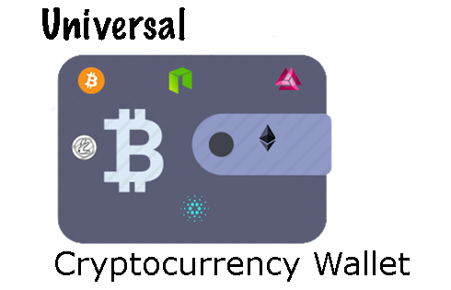
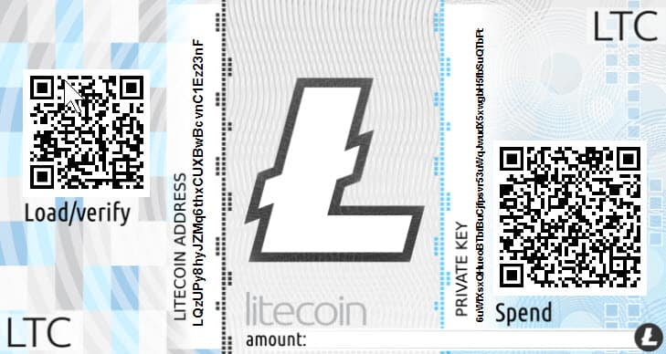
Specialized vs Universal

Slide 45
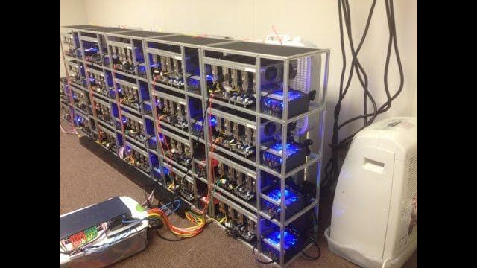
Full Node Wallets
Bad
Builds copy of entire blockchain
Lots of disk space
Runs all the time to keep up
Advertises your IP address
Good
Most Trustworthy data ever!
Notes:
Full node wallets build up a copy of the entire blockchain. That’s lots of space and lots of CPU cycles, running all the time to keep up. Also, you broadcast your IP address to the world. On the other hand, your wallet is super-accurate, since you are sync'd with 8 other full nodes.

Slide 46
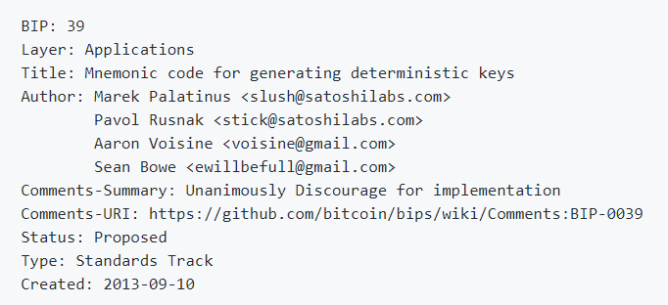
Hierarchical Deterministic Wallets
Old-School wallets
Every now and then …
Generate bunch of private keys & addresses …
And back them up!

Slide 47
Hierarchical Deterministic Wallets
Generate a multi-word mnemonic
“under the Moorish wall and I thought well as well him as another”
Generate master key pair from mnemonic
Guard mnemonic and master keys like nuclear codes!

Slide 48
Mnemonic
Master Private key
+1
+2
+3
+…
Private key 1
Private key 2
Private key 3
Private key …
Address 1
Address 2
Address 3
Address ...
Linear sequence of key-address pairs

Slide 49
The Hierarchy
Boss

Slide 50
The Hierarchy
Boss
Accounting

Slide 51
The Boss Partitions keys
Boss
Tech
Marketing

Slide 52
The Boss Partitions keys
Boss
Boss can read anything she wants
Tech
Marketing

Slide 53
Access Control
Boss
Underlings can’t read up
Tech
Marketing
Notes:
Cannot derive upstream keys

Slide 54
Wallets and Privacy
Dusting attack

Slide 55
Dusting Attack
Airdrop!

Slide 56
Dusting Attack
10⁻⁸
10⁻⁸
10⁻⁸
Give everyone a tiny sum
(each with a unique address)

Slide 57
Dusting Attack
It’s so annoying to have
all these UTXOs …
1000
10⁻⁸

Slide 58
Dusting Attack
I have you now, my pretty!
I have just linked your address with you!
1000
txn
1000+
10⁻⁸

Slide 59
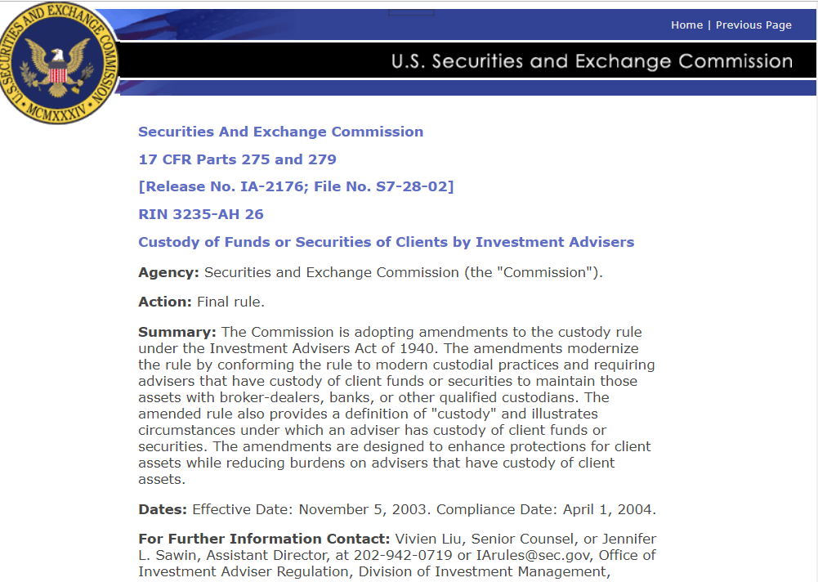
Custody
If you can steal it, you have custody
If you have custody, you are regulated

Slide 60
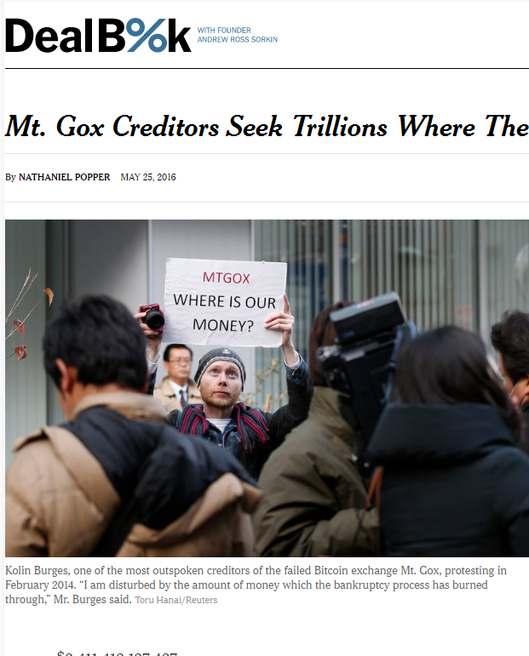
Disadvantages of Custodial Wallets
Your money could be
stolen by hackers
lost or stolen by bankers
confiscated by the government
Notes:
Tabloid scandals and mysteries abound. Mt Gox, a Japanese site that acted as a bank for Bitcoin holdings seems to have “lost”, somehow, about $600 M of depositor’s money, all in Bitcoin. It has never been explained whether this money was stolen, whether the keys were simply lost, or whether something more complicated happened.

Slide 61
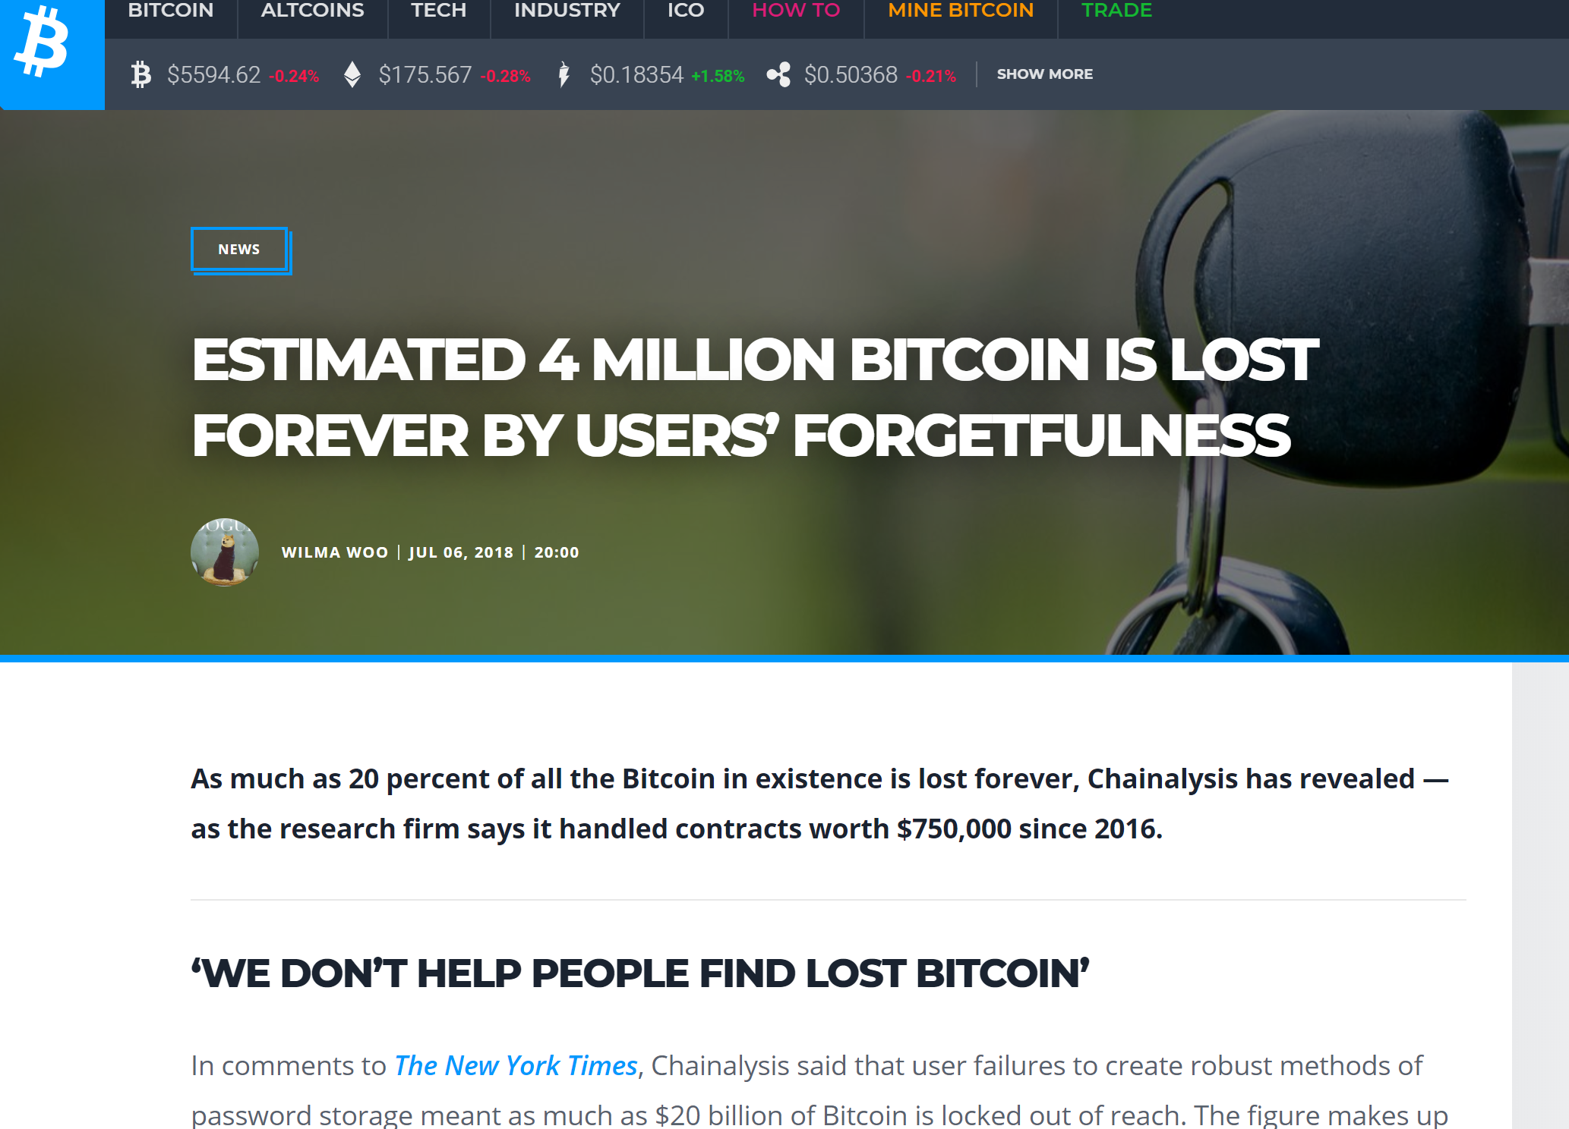
Advantages Non-Custodial
Disadvantages of Non-Custodial Wallets
People are idiots

Slide 62
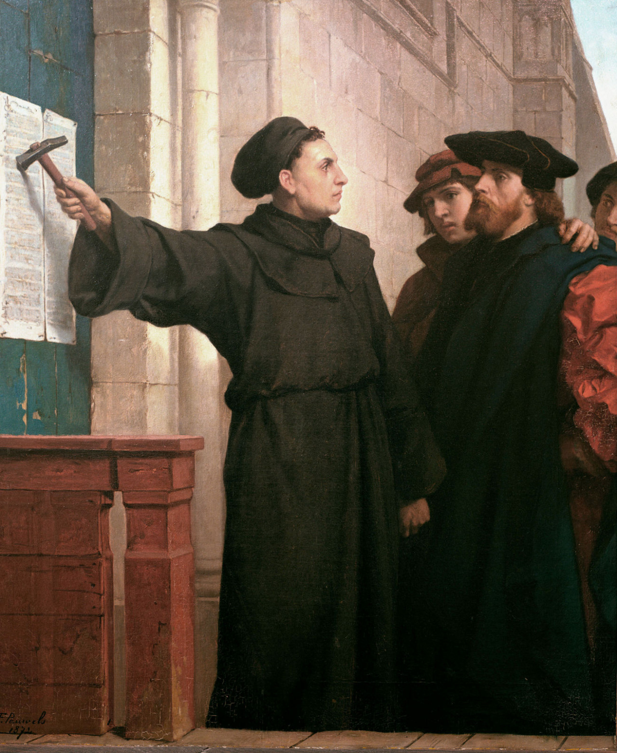
Ideas we covered in this lecture
Wallets
Software, hardware, paper
Universal, specialized
Hierarchical deterministic wallets
Legal notions of custody

