Slide 1
CS1951 L
Blockchains & Cryptocurrencies
Spring 2024
Lecture 2
Bitcoin
Maurice Herlihy
Brown University

Slide 2
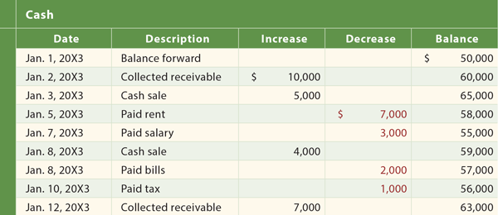
Abstraction: Distributed Ledger
Append-only list of events
Not just financial
Everyone agrees on content
Tamper-proof!

Slide 3
Clients ….
Miners …

Slide 4
Clients ….
send transactions …
to miners.

Slide 5
Miner batches transactions in blocks

Slide 6
Miners …
do consensus to pick one block …

Slide 7
Chain Property
Control x% of miners, control x% of blocks
Not always true but close enough for now
Notes:
http://safeact.com.au/wp-content/uploads/2014/01/safety.png

Slide 8
Problem: Double Spending
dbea25daf536
dbea25daf536

Slide 9
Old-School Solution
mint
dbea25daf536
eff3887207be

Slide 10
Nakamoto Solution
Public
ledger
dbea25daf536
dbea25daf536

Slide 11
Nakamoto Solution
Public
ledger
dbea25daf536
dbea25daf536

Slide 12
Liveness
Decide nothing?
Trivially safe
Want to guarantee that good things happen

Slide 13
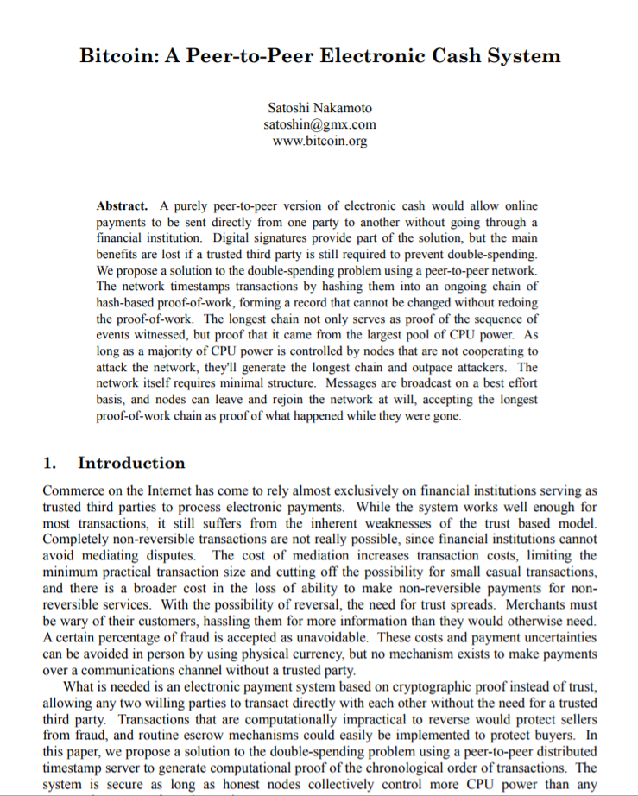
Illustrate ideas using the original paper
Notes:
Bitcoin, Ethereum, ICOs, blockchains, etc. are the result of a single paper (and running code) that appeared mysteriously in 2008. I am going to claim it’s all about distributed computing, but it did not come from the distributed computing research community. I feel confident speculating that if this paper had been submitted to PODC in 2008, it would have been rejected for defining consensus weirdly, or not proving any lemmas, or not providing experiments. Yet here we are, looking at a new, vibrant, and active area of CS. What are we to make of it?

Slide 14
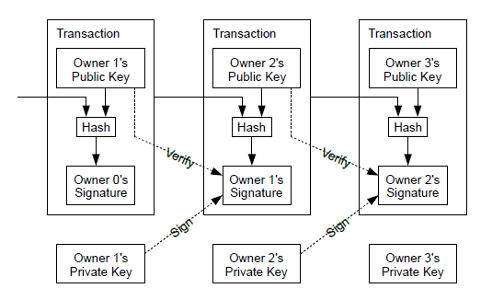
How it works

Slide 15
New owner’s identity
How it works
Tamper-proofing
Old owner’s signature

Slide 16
Every node keeps a copy of every transaction
(except maybe SPV nodes, later)
Widely considered reckless at the time
Still a scalability issue

Slide 17
Nakamoto Consensus in One Line
hash of last block on longest
branch
public
key
difficulty
SHA256( h | T | K | nonce ) < D
standard
hash
function
transactions
Find this!

Slide 18
Nakamoto Consensus in One Line
SHA256( h | T | K | nonce ) < D
No formal proof of collision-resistance
Possible quantum attacks?
Ethereum uses similar, not same hash

Slide 19
Nakamoto Consensus in One Line
SHA256( h | T | K | nonce ) < D
Tamper-proofing
Key in key-value store

Slide 20
Nakamoto Consensus in One Line
SHA256( h | T | K | nonce ) < D
Actually hash of txn “Merkel tree” root
Constant size
Too expensive to hash txns themselves

Slide 21
Nakamoto Consensus in One Line
SHA256( h | T | K | nonce ) < D
Pay “coinbase” reward to this address

Slide 22
Nakamoto Consensus in One Line
SHA256( h | T | K | nonce ) < D
Too easy? frequent forks, slow finality
Too hard? low throughput
Adjusted dynamically: ~1 block / 10 min

Slide 23
Nakamoto Consensus in One Line
SHA256( h | T | K | nonce ) < D
Keep trying one after another …

Slide 24
Find a value to put here …
To give this hash k leading 0s

Slide 25
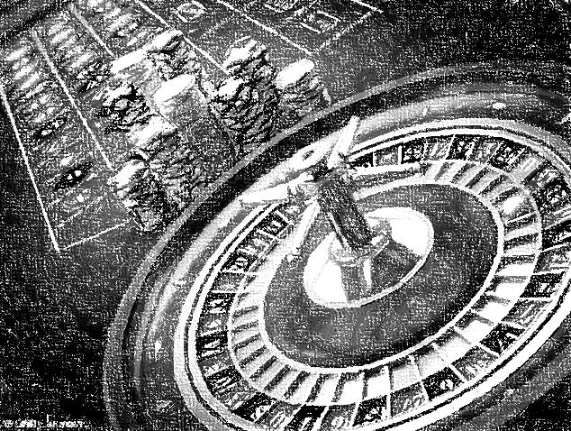
“Proof-of-Work” arguably a misnomer
Randomization is important
Otherwise, most computational power always wins
Instead, chance of winning is proportional to power
Still, danger of capture by big miners

Slide 26
Questions?

Slide 27
Longest Chain Rule
Honest miners build on longest chain …
… longest chain reflects will of honest miners
Dishonest miners would have to out-compute all honest miners

Slide 28
Limited Throughput is Feature, not Bug
Number of blocks/time kept approximately constant
By varying PoW difficulty
This will become a problem as Bitcoin becomes successful

Slide 30
On the Bitcoin P2P layer
Clients send transactions to miners
Rumor: mining cartels use faster side-channels

Slide 31
Miners assemble transactions into blocks
Economy of scale: single transaction too expensive
Block size becomes major headache later on!

Slide 32
Miners race to do Proof of Work
Today, consumes lots of energy
Cartels with access to cheap power and ASICs control most of hashing power

Slide 33
If multiple winners at the same time …
the blockchain forks …
Result: high latency because need to wait until your transaction deep enough in chain

Slide 34
Sanity check: malformed txns rejected
Incentive for miners to behave …
Double spending filter
(not actually necessary?)

Slide 35
Successors build on recent well-formed blocks
Pick longest chain if there is a fork
Break ties arbitrarily

Slide 36
Where’s my Money?
You mine a block, you get paid
How new bitcoins are generated
“Coinbase” transaction

Slide 37
Where’s my Money?
Customers can include transaction fee
Higher fees buy lower latency?
This will be a problem later …

Slide 38
Deflationary
Limit on number of BTC ever minted
Fear of inflation?
But not deflation?
Deflation implies inflated fees

Slide 39
Crime doesn’t Pay
Suppose dishonest party acquires lots of hashing power …
Unlimited double spending?
Or collect all the rewards?
Vandalism destroys coin values!
39

Slide 40
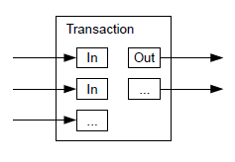
UTXO Model

Slide 41
UTXO Model
A txn can have multiple inputs …

Slide 42
UTXO Model
… and multiple outputs

Slide 43
UTXO Model
pizza order
change

Slide 44
UTXO Model
Can also place other conditions on transfer …
smart contracts

Slide 45
Privacy
Old-school: Trusted 3rd party keeps IDs secret

Slide 46
Privacy
Bitcoin: all transactions visible
Public sees only keys
Which can still leak information
“pseudonymous”

Slide 47
Calculation
Back of the envelope calculation
How likely dishonest miner can overtake honest miner to reverse transaction?
Exponentially small in gap size
Calculation naïve but probably mostly right

Slide 48
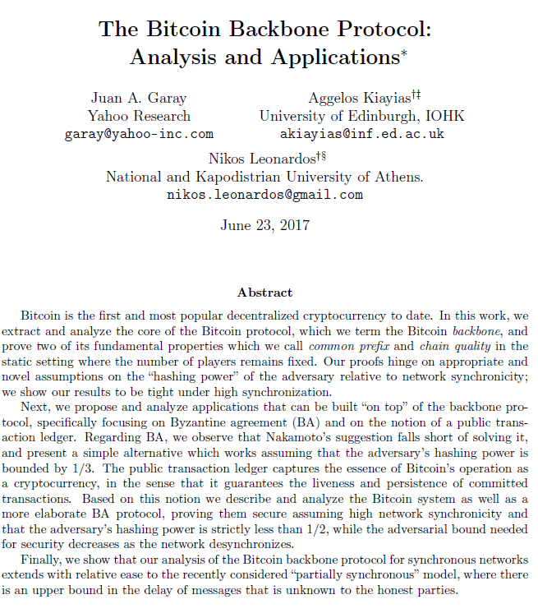
Here is a more complete calculation …
Lots of Chernoff bounds …
more precise statements of correctness
more precise bounds on hashing power

Slide 49
PoW and decentralization

Slide 50
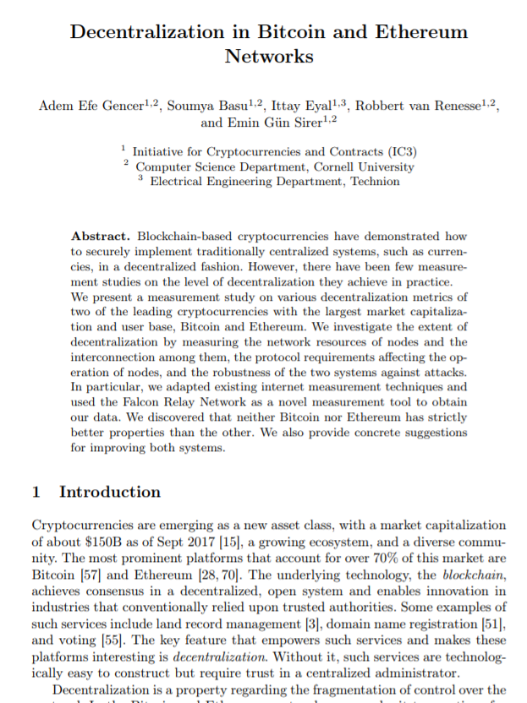
Beware of Fake Decentralization
Bitcoin (& Ethereum) are pretty centralized
Top 4 Bitcoin Miners > 53% power
Top 3 Ethereum miners > 61% power
15 Bitcoin, 11 Ethereum miners > 90%

Slide 51
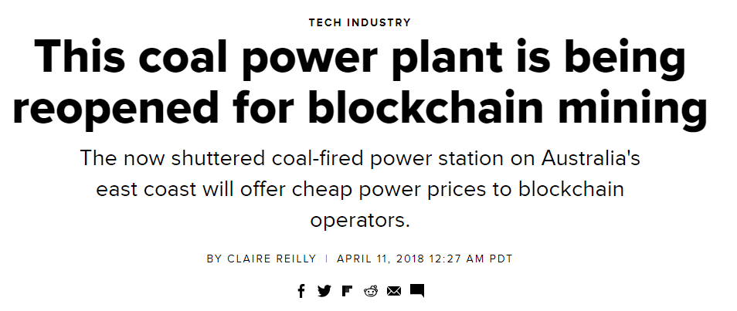
PoW Encourages Centralization
Power to the people …
who live near cheap energy?

Slide 52
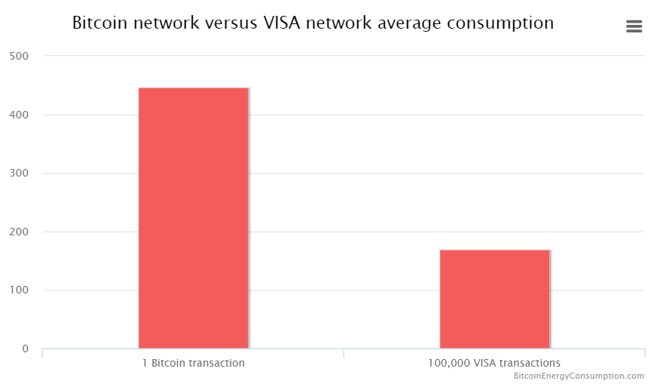
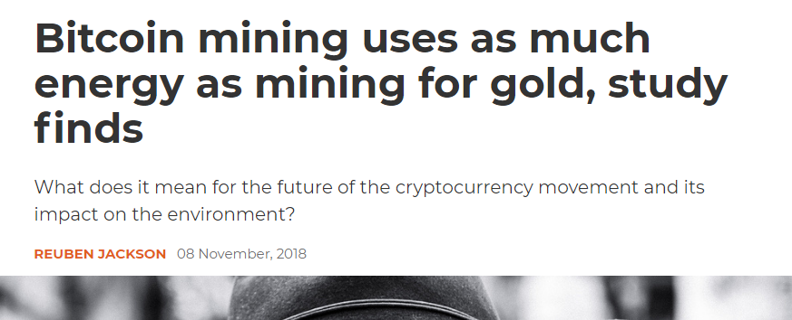
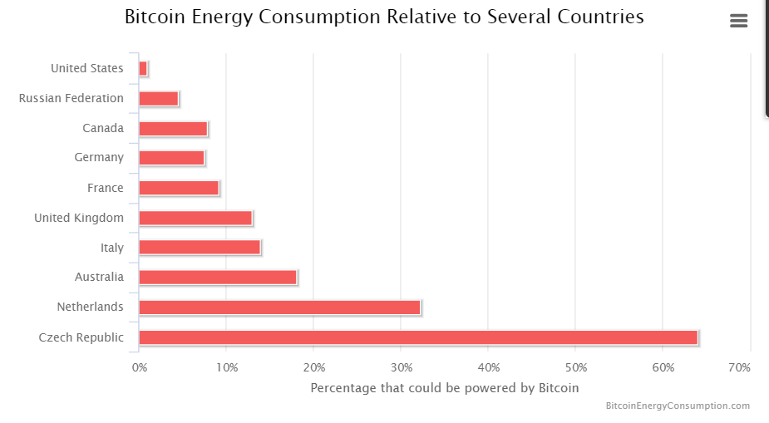
Wasteful

Slide 53
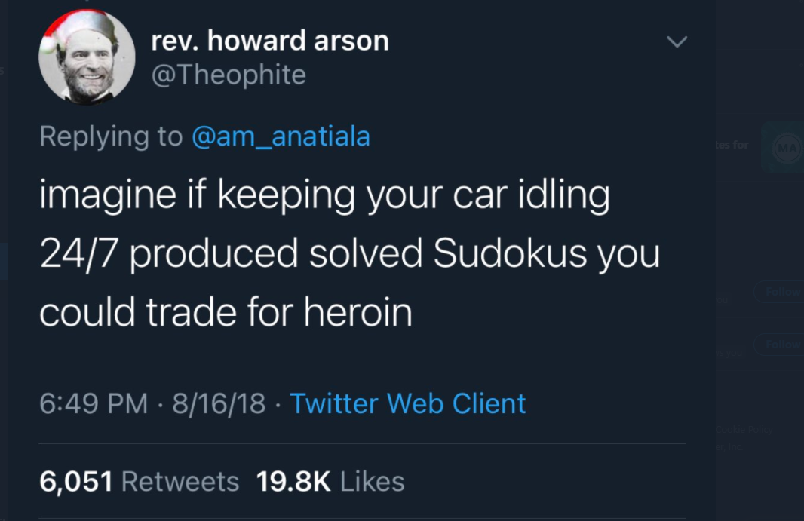

Slide 54
Trigger Warning:
Opinions

Slide 55
Classic, well-written paper.
But we can’t read it like it’s still 2008
Like the Communist Manifesto, things didn’t turn out quite as expected …
Notes:
Bitcoin, Ethereum, ICOs, blockchains, etc. are the result of a single paper (and running code) that appeared mysteriously in 2008. I am going to claim it’s all about distributed computing, but it did not come from the distributed computing research community. I feel confident speculating that if this paper had been submitted to PODC in 2008, it would have been rejected for defining consensus weirdly, or not proving any lemmas, or not providing experiments. Yet here we are, looking at a new, vibrant, and active area of CS. What are we to make of it?

Slide 56
Motivation
Commerce on the internet == credit cards
Problem: credit card transactions are reversible
NB: only a problem from merchant’s PoV

Slide 57
Motivation
Mediation = friction & inefficiency
Merchants must decide whom to trust, so they spy on you for credit scores
BTC as credit card replacement!

Slide 58
Motivation
Irreversible charges protect merchants
(Consumers don’t deserve protection?)
No recourse for theft, fraud, …

Slide 59
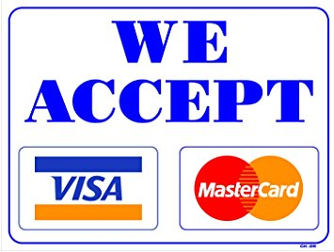
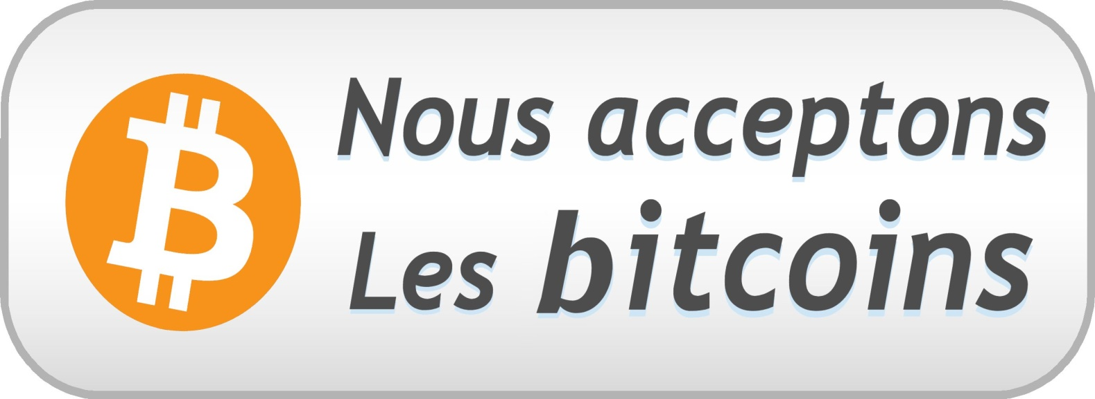
“Would you be willing to give up your miles in return for never being able to dispute a transaction?”
One-sided protection for merchants, none for consumers.
Oh, did someone steal your secret keys?
(In Libertarian Paradise, Bitcoin spends you.)

Slide 60
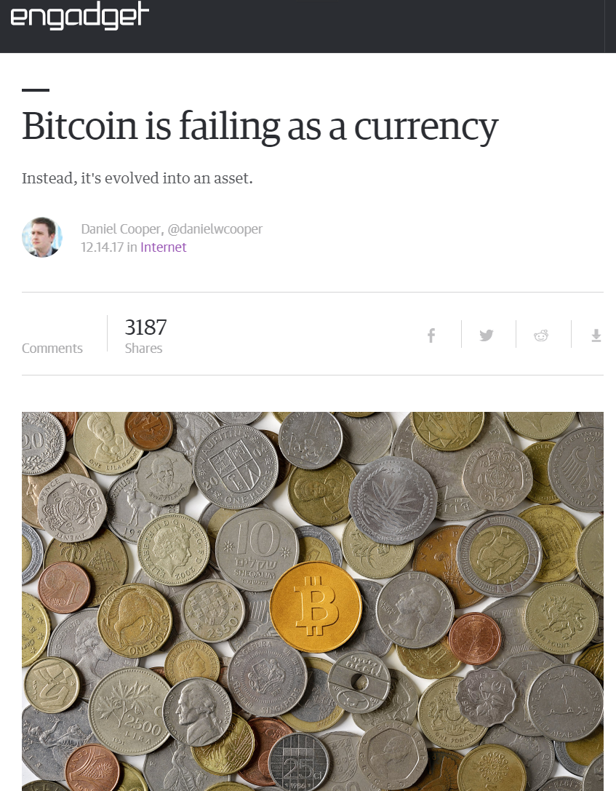
Money serves two purposes:
Medium of exchange (buy beer)
store of value
(keep under mattress)
60

Slide 61
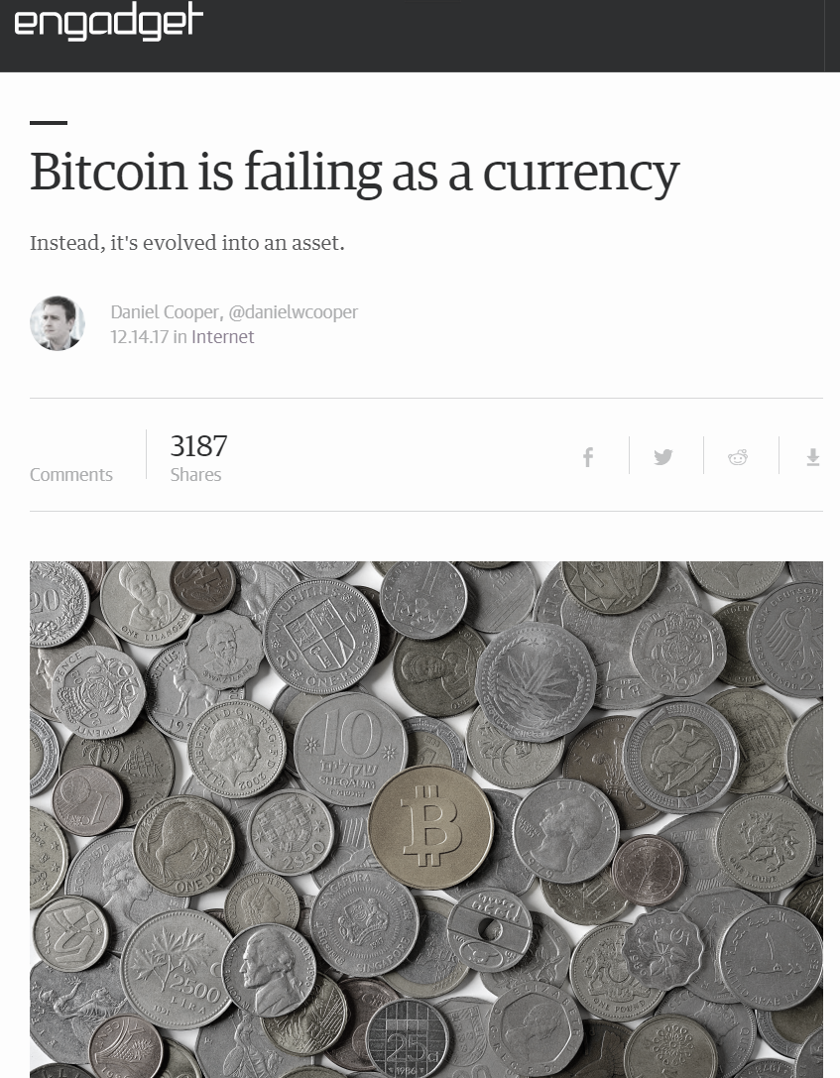
Money serves two purposes:
Medium of exchange (buy pizza)
store of value
(keep under mattress)
Crazy Success (until it isn’t)
61

Slide 62
Money serves two purposes:
Medium of exchange (buy pizza)
store of value
(keep under mattress)
Not so much.
62

Slide 63
Would Nakamoto recognize today’s Bitcoin?
Nakamoto’s vision: BTC as (one-sided) credit card replacement on internet.
He never anticipated only actual use: speculation

Slide 64
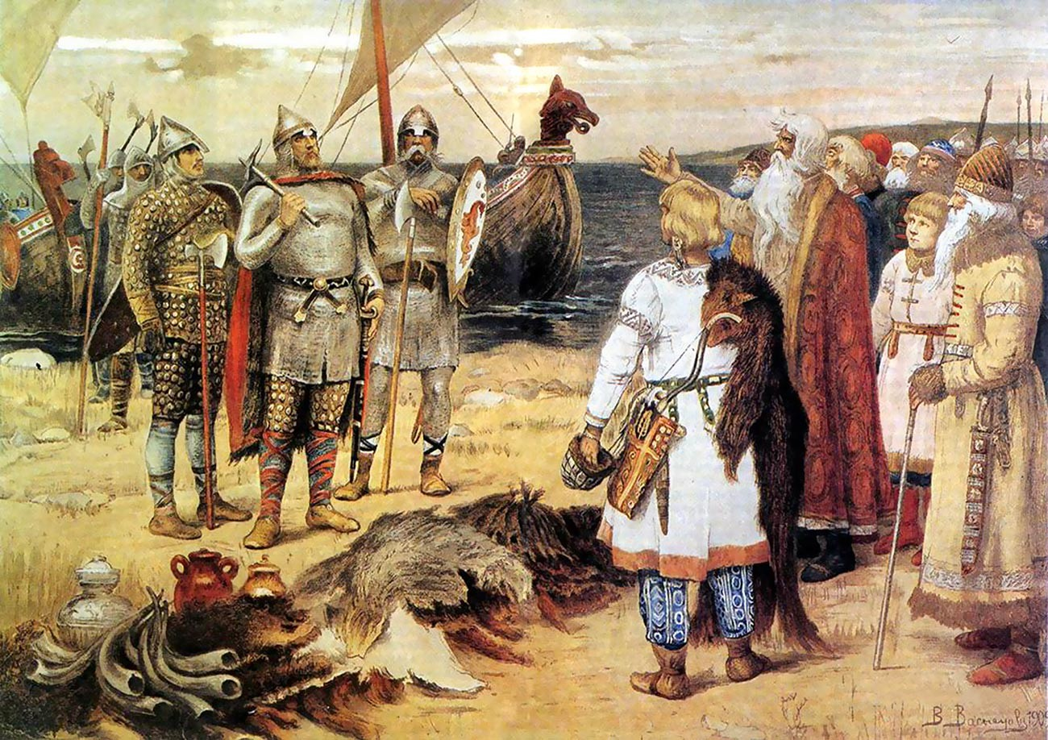
Mutual benefit if we co-operate
But we don’t trust each other
Can’t sue in court
Not a New Problem

Slide 65
Number go up
Why should I spend coins worth more tomorrow?
Why should I take coins worth less tomorrow?
Number go down
Buyer
Seller

Slide 66
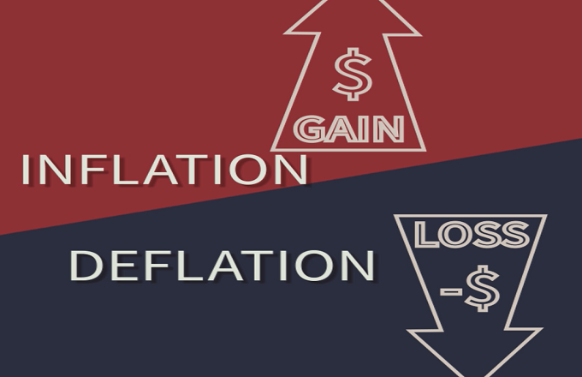
Nakamoto feared inflation ….
But deflationary economies depressed because rational players don’t spend money

Slide 67
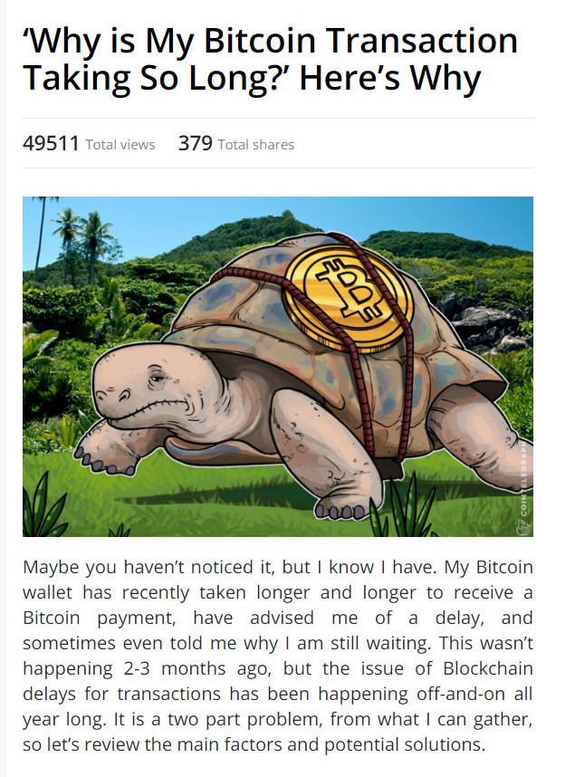
Problem Long or Unpredictable Completion Times

Slide 68
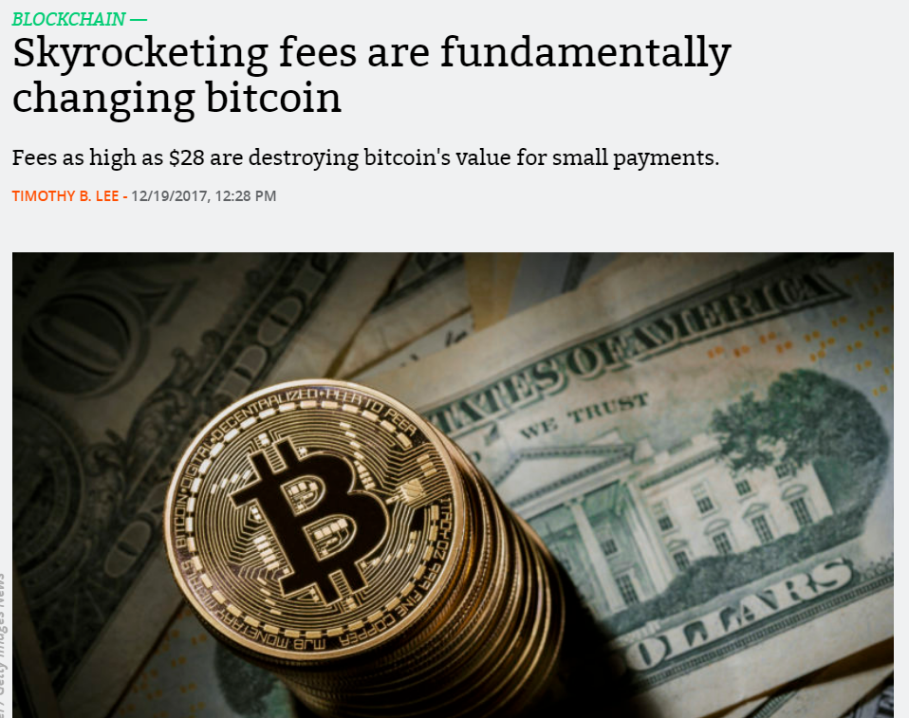
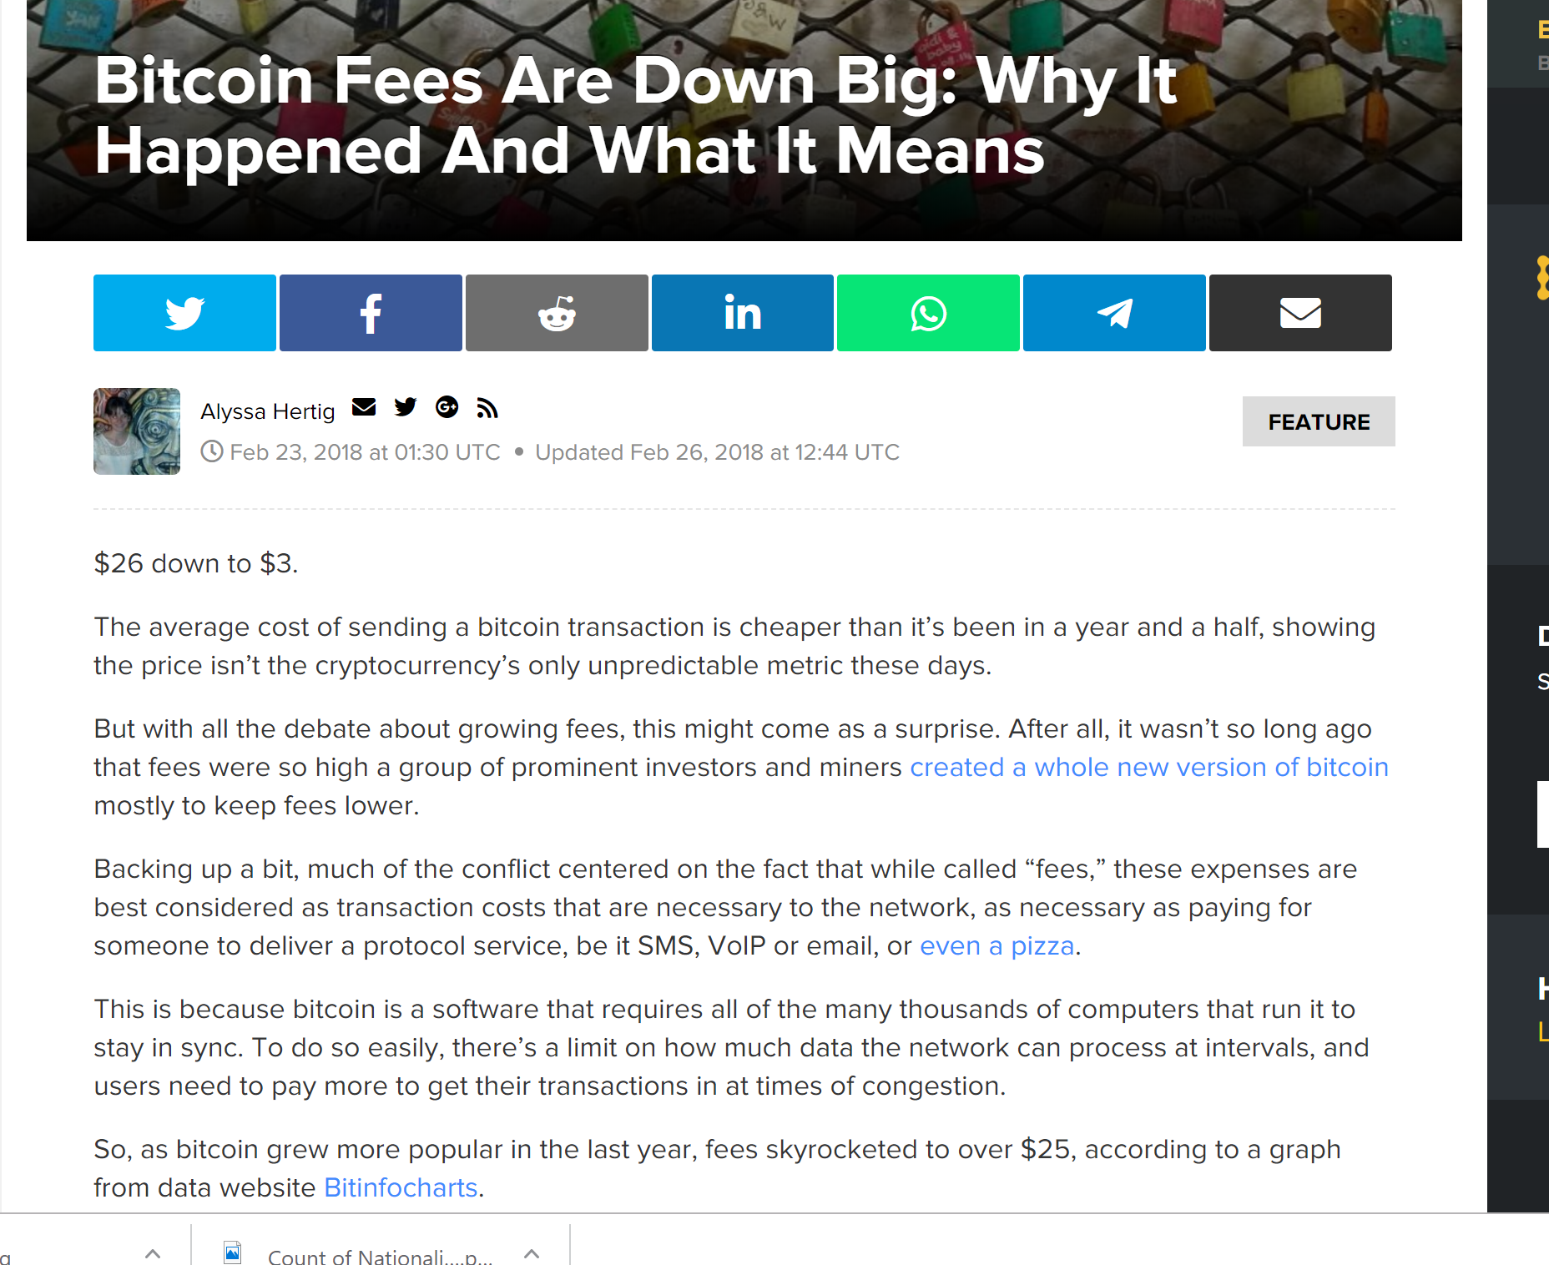
Problem: Fee Volatility

Slide 69
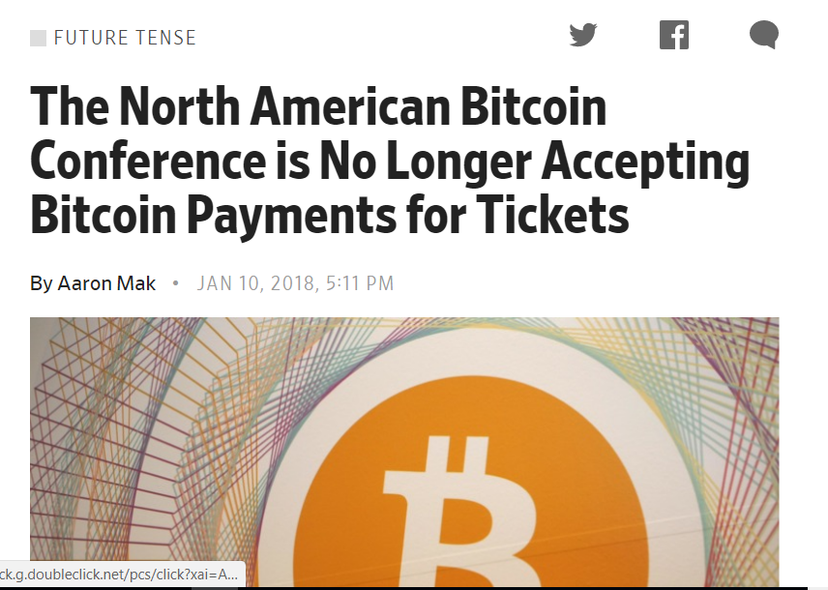
Convenience vs Ideology

Slide 70
Bitcoin Investing is like a casino …
Must buy chips to play …
But the house won’t buy them back …
Can only sell to incoming players ….
Works only as long as money in ≥ money out

Slide 71
“You can leave any time you like, but you might not be able to check out”
(This is not investment advice)

Slide 72
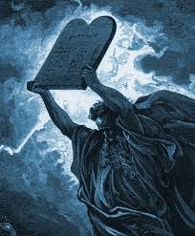
Bitcoin Governance Theory
Canonicalism:
All and only what Satoshi revealed is permitted
Appealing to the faithful …
But fails to explain upgrades …
… and bug fixes.

Slide 73
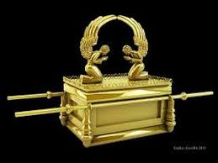
Actual Governance?
De facto governance by …
“Core Bitcoin Devs”
Commit access to bitcoind
Supported by the Bitcoin Foundation
Controversy wrt block sizes, etc.

Slide 74
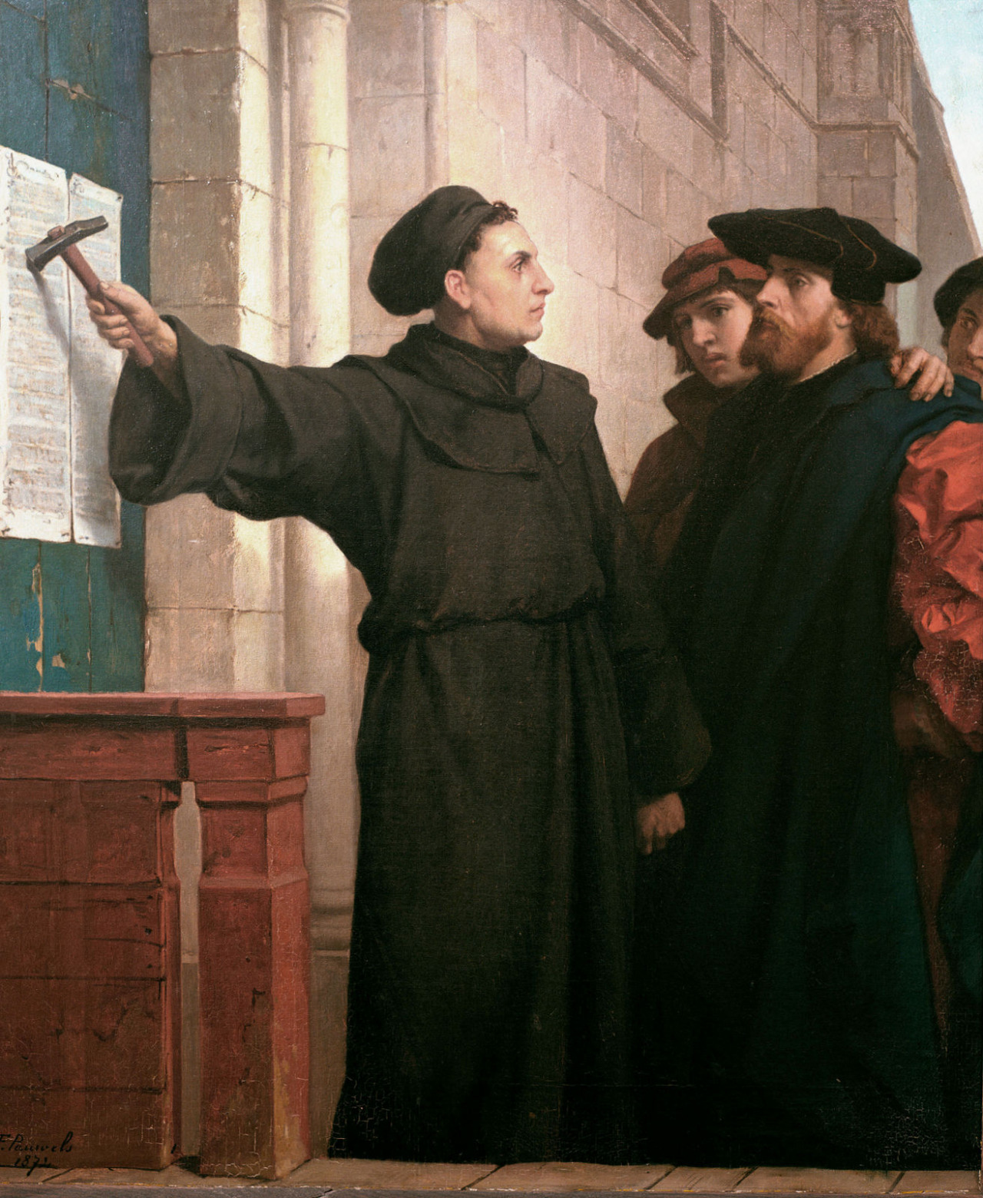
Ideas we covered in this lecture
BTC Blockchain is linked list of blocks
Block is sequence of transactions
Transaction = UTXO
Use of hashes and signatures
Incentives for miners
Economic incentives

Slide 75
